Slide 1


Data Visualisation
Qlik Sense®

Slide 2
Contents

Slide 3
Contents
 | Slide
Visualisation process | 6
Introduction to Qlik Sense® | 15
Installation process | 19
Qlik Sense® basics | 21
Qlik Sense® user interface | 47
Hands on exercise - CORDIS | 58
Qlik Sense® other features | 118
Hands on exercise – Problem Solving | 122
Individual projects & Presentation | 133

Slide 4
Roundtable and introductions

Slide 5
Roundtable and introductions
Who am I?
    Name
    Business
    Etc.
Which data am I working with?
What experience do I have with Qlik Sense or other visualisation tool?
What would I like to learn?

Slide 6
Visualisation process

Slide 7
Visualisation Process
Different stages of visualisation
Good visualisation is about making good decisions.
To make the best decisions you need to be familiar with all your options and aware of the things that will influence your choices.
In order to end up with a satisfying result in data visualisation, it is important to follow a step-by-step process approach in order not to overlook any relevant options.
There are four main stages of this process:
1
2
3
4
Formulate the question
Collect and prepare data
Consider medium
Develop visual representation

Slide 8
Visualisation Process
Different stages of visualisation
When creating a visualisation, the first step should always be to clearly state the question to be answered.
By being conscious of the answer we need, we can more effectively choose the data required to answer it.
A common mistake is to dive head first into all the available data and end up losing the initial goal and over-complicating a rather simple process.
1
Formulate the question

Slide 9
Visualisation Process
Different stages of visualisation
Collect Data
Before being able to visualize it is important to collect the data needed to answer the business question.
It is important to consider the following:
What do we want to represent?
Which variables contain this information?
What type of variables are they?
What are their properties (e.g. range)?
In this step we ensure that we have all the data we need in the right structure.
After collecting the data it is also best to do some sense checks on the data such as:
How accessible is the data for all stakeholders?
Is the content of the data still valid, consistent and accurate?
Is the data relevant to my business question?
Is the data in the correct format for my visualisation?
Did we use the right granularity for all?
Is my data set complete?
2
Collect and prepare data

Slide 10
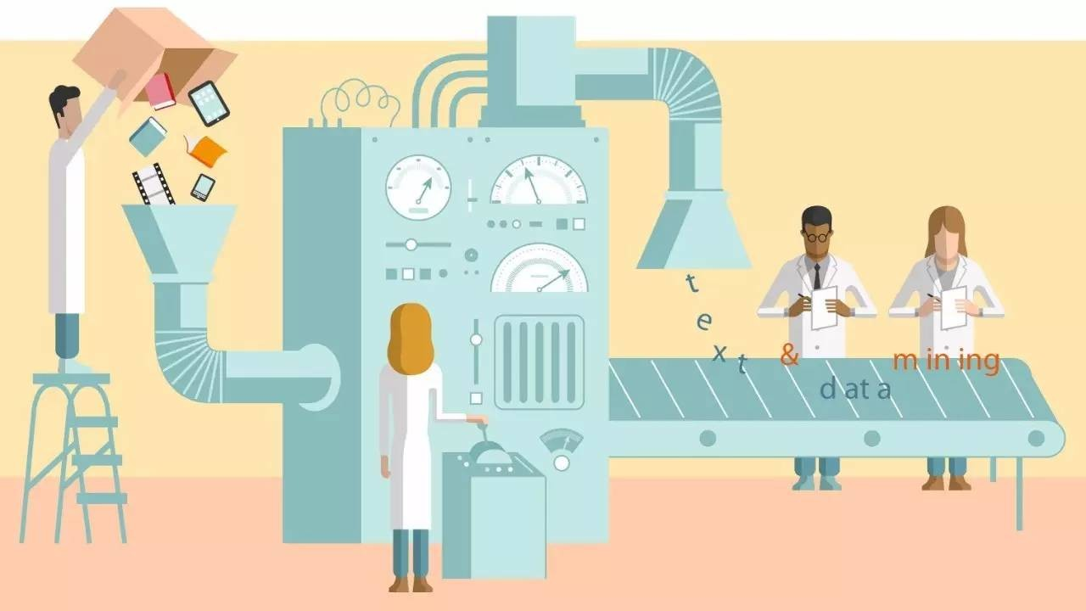
Visualisation Process
Different stages of visualisation
Prepare Data
After collection some additional data preparation might be required. Here it is important to check if amongst others:
Additional computed variables need to be created
Filtering on the data is needed
Links between different datasets are required
Etc.
2
Collect and prepare data

Slide 11
Visualisation Process
Different stages of visualisation
When preparing or collecting data it is important to understand the different types of data available:
Quantitative
Qualitative
Data dealing with numbers
Data which can be measured
Two types:
  Categorical
  Continuous
E.g.: length, volume, speed, weight category, coordinates, etc.
Data dealing with descriptions
Data can be observed but not measured
Data can be categorical only
E.g. colours, mood, countries, etc.
2
Collect and prepare data

Slide 12
Visualisation Process
Different stages of visualisation
Some examples:
Geospatial
Network
Textual
Data specifying a location in space and time
E.g. Coordinates:
Lat: 51.0543, long: 3.7174
N 51 3’16”, E 3 43’3”
Representing a hierarchical or non-hierarchical relationships/interactions between entities
Examples include:
  Graphs representing relationships between entities (e.g., FB friends);
  Interactions (e.g., communication traces in social networks);
  And hierarchies (e.g. taxonomies).
E.g. linkedin data
Data consisting of text
Usually analysed to produce:
  Text categorisation;
  Text clustering;
  Concept and pattern extraction;
  Document summaries,
  And sentiment analysis etc.
Has to be “mined” before analysis
E.g. Shakespeare (sonnet 18)
2
Collect and prepare data

Slide 13
Visualisation Process
Different stages of visualisation
In order to choose a good medium a couple of questions should be asked. Some examples could be:
Will the visualisation be printed or digital?
  In print we have a set space that we can predefine, while digitally we have to take into account how it will look on different screen types and sizes.
  In print the colour output can be tested and set, but digitally colours can appear differently from screen to screen, and ruin the outcome.
Will it be static or interactive?
  If it is static all we need to do is design a single layout. But if it’s interactive we have to consider how elements change and how this affects the information conveyed and the aesthetics of the bigger picture.
3
Consider medium

Slide 14
Visualisation Process
Different stages of visualisation
Now is it time to decide on the appearance of the visualisation itself.
The optimal visualisation design depends on two factors, primarily:
the message to be conveyed to the audience or the question to be answered
and the variables to be shown.
Different types of visualisation are available such as:
Charts (barchart, linechart, piechart, etc.)
Static powerpoints
Interactive dashboards
Pictures
Infomercials
Movies
Etc.
4
Develop visual representation

Slide 15
Introduction to Qlik Sense®

Slide 16

Introduction to Qlik Sense®
What is Qlik Sense®?
Qlik Sense® is a platform for visual data analysis. It allows users to easily analyse data and uncover useful insights.
It is highly flexible and aims to create actionable insights that can lead to meaningful impact.
Qlik Sense® , allows to share this knowledge with others. It also provides the opportunity to analyse in groups or across different organisations.
Notes:
Link: https://help.qlik.com/en-US/sense/1.1/Content/Introduction.htm (Qlik)

Slide 17
Introduction to Qlik Sense®
What are the key strengths?
Interactive interface
User empowerment
Dynamic data management
  Easy handling of follow-up questions
  Allows for a dynamic iterative process
  Develop your own data visualizations
  Build dashboards on ad-hoc data sources
  Tailor-made solutions
  Flexibility in the use of data sources
  Open connection allowing continuous updates
  Data processed “in memory” increasing speed
Notes:
Develop your own data visualizations:
With the provision of a simple base set of functions, users are able to easily and autonomously build new visualizations and uncover insights.
Build dashboards on ad-hoc data sources:
With simple access and linking of data sources, users can import new ad-hoc data sources to their dashboard
Tailor-made solutions:
With the necessary technical expertise, it is possible to create genuinely unique customised dashboards and visualisations for any purpose necessary.
Dynamic data management
Flexible:
Qlik Sense allows to connect with a wide array of data sources and combinations them. Furthermore, it maintains an open connection with any data source used, thus any update in the source is automatically reflected in the app.
Fast:
An important strength of Qlik Sense is that all data is loaded and processed “in memory”. This allows for significantly faster loading and processing times.
Link: https://help.qlik.com/en-US/sense/1.1/Content/Introduction.htm (Qlik)

Slide 18
Introduction to Qlik Sense®
What are the key strengths?
Mobile Friendly
Easy publication and collaboration
Story telling feature
  Responsive design
  Allows for visualizations and build on all mobile devices
  Publish and share an app embedded in websites
  Qlik cloud
  Pdf or image exports
  Data exports in current states
  Provides narration to enable clear communication
  Combines visualizations, reporting, presentation and analysis techniques
Notes:
Mobile Friendly
Responsive design:
Qlik Sense allows users to develop multi-device experiences without having to test for the various environments. The fully responsive experience allows adaptability to any user device (Laptop, iPad, iPhone).
Visualise & Build:
Furthermore, it also supports the creation and editing of the visualisations on all these devices mobile devices.
Multiple ways to Publish & Share work
There are various ways to publish and/or share visualisations with Qlik Sense:
Publish and share an app or parts of it in interactive form embedded in a website
Publish and share the whole app or parts of it through the Qlik Cloud
Export a visualisation or whole set of them as a PDF
Export visualisations as images (jpeg, png file)
Export the data included in visualisations as per its current state (i.e. taking into account filters, sorting etc.)
Link: http://www.qlik.com/us/products/qlik-sense/qlik-sense-cloud

Slide 19
Qlik Sense® installation process

Slide 20
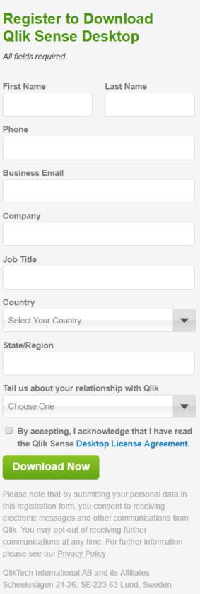
Qlik Sense® installation process
The software used for this workshop is Qlik Sense® Desktop.
To install it:
Navigate to the following website:
http://www.qlik.com/try-or-buy/download-qlik-sense
Fill in the form and click “Download Now”;
Once downloaded, run the installer and install the client.

Slide 21
Qlik Sense® basics

Slide 22
Qliksense® basics
Overview
Associative selection model
Selection colours
Apps
Sheets
Visualisations
Functions
Expressions
Dimensions
Measures
Master items
Seeking help

Slide 23
Qlik Sense® basics
Associative selection model
Making selections is the main interaction method in Qlik Sense®. Selections filter out a subset of the data that is loaded into Qlik Sense®.
Selections are done by clicking on the visualisations.
Multiple selections over different visualisations are connected with an AND logical relationship. This means that data displayed will be only that which fits all selections.
This means that the more selections one makes the more he refines the focus of his selection.
Complete dataset
Filter 1
Filter 2

Slide 24
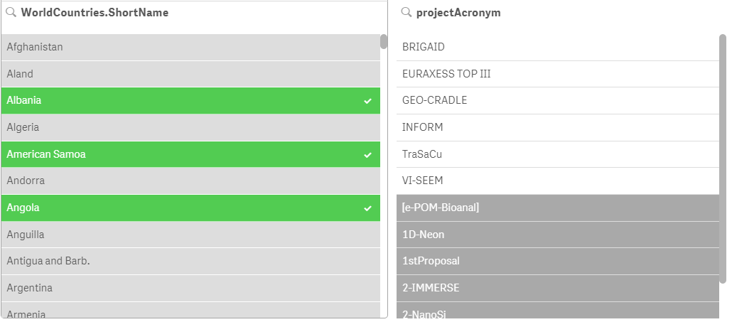
Qlik Sense® basics
Selection colours
In Qlik Sense® there are three colours when it comes to selection:
indicates selected values;
indicates associated values;
indicates non-associated values.

Slide 25
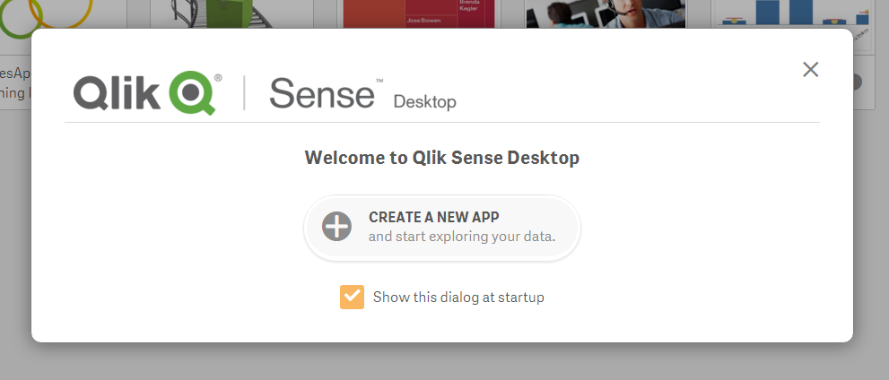
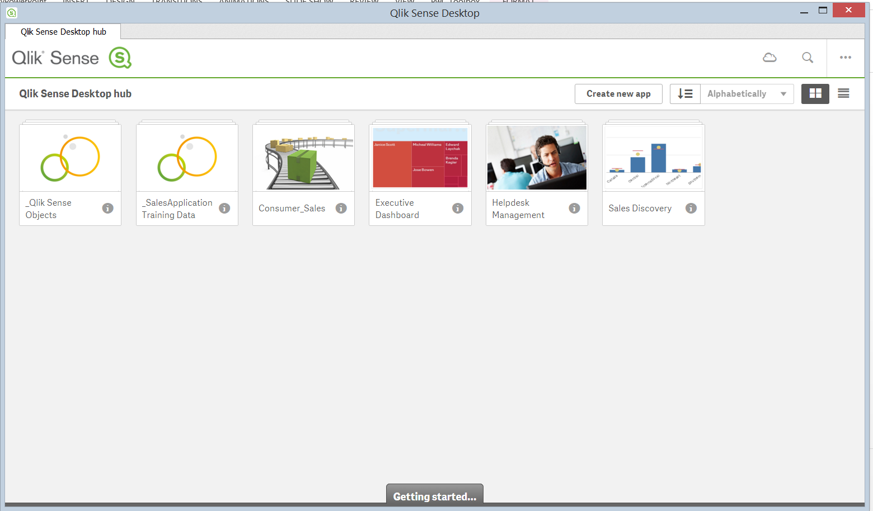


Qlik Sense® basics
Apps
The main component of Qlik Sense® is the App.
An app is made up of a combination of:
  Sheets containing data objects (i.e. measures, dimensions, variables and visualisations);
  Bookmarks;
  and Stories.
The app also includes the data needed to perform analysis in a structured data model.
Example file:
Example of an app

Slide 26
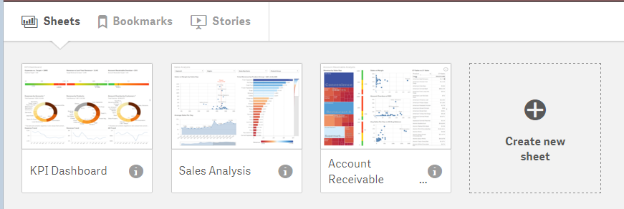
Qlik Sense® basics
Sheets
A sheet is where the data objects are placed. An app can include several sheets.
Every sheet can be viewed in its edit view for editing and its done view for exploration and analysis.
Remember! The various sheets in an app are connected to each other. This means that selections you make one sheet affect the visualisations on the other sheets as well.

Slide 27
Qlik Sense® basics
Visualisations
Visualizations are used to present the data loaded in the app.
Qlik Sense® includes chart items which are what you use to create visualizations.
Often you can convert from one chart to another while keeping all values and data untouched. This helps when you want to view a visualisation from a different perspective.

Slide 28
Qlik Sense® basics
Visualisations
Qlik Sense® provides a diverse set of visualisation types to display data according to the needs of each circumstance.
Bar charts
Combo charts
Line charts
Scatter plots
Pie charts
Filter panes
(Pivot) Tables
Maps
KPIs
Gauge
Tree map

Slide 29
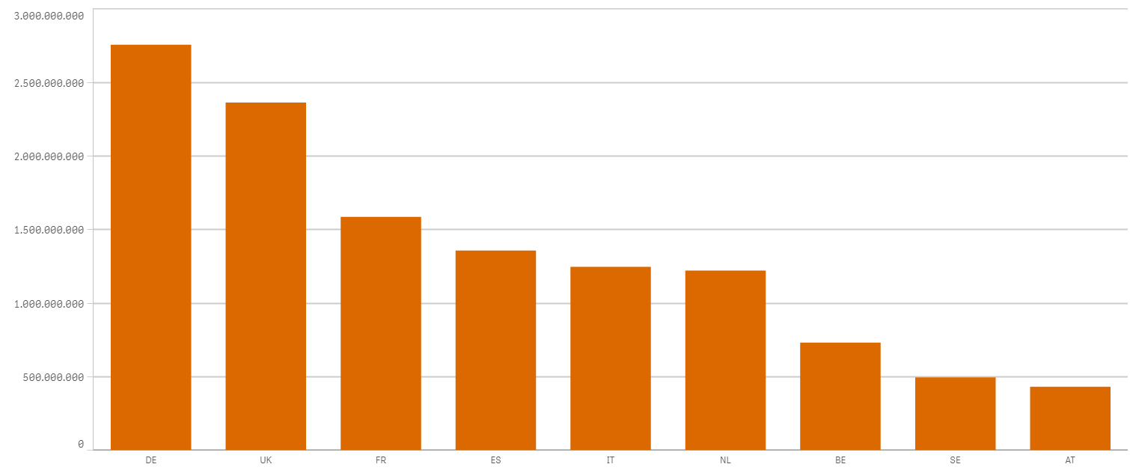
Qlik Sense® basics
Visualisations
Bar chart
It is used to compare items and data over time.
Grouping and stacking bars makes it easy to visualize more than one measures.
It is used to visualise the different values of a measure in different categories.

Slide 30
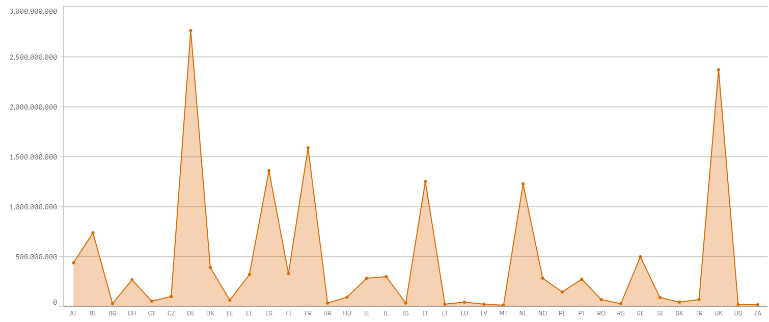
Qlik Sense® basics
Visualisations
Line chart
It is used to display trends and compare changes over time. It is best used when the horizontal dimension is evenly spaced, such as the case with months, quarters, or fiscal years.

Slide 31
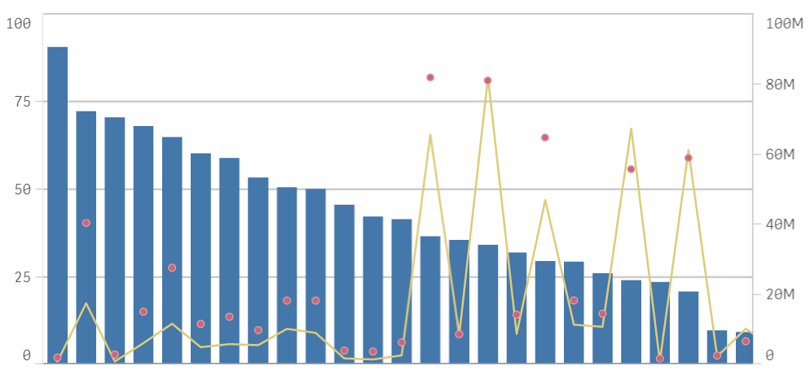
Qlik Sense® basics
Visualisations
Combo chart
It combines absolute and relative values by combining features of the bar chart and the line chart.
You can use bars and lines to represent different categorical groups in the same visualization.

Slide 32
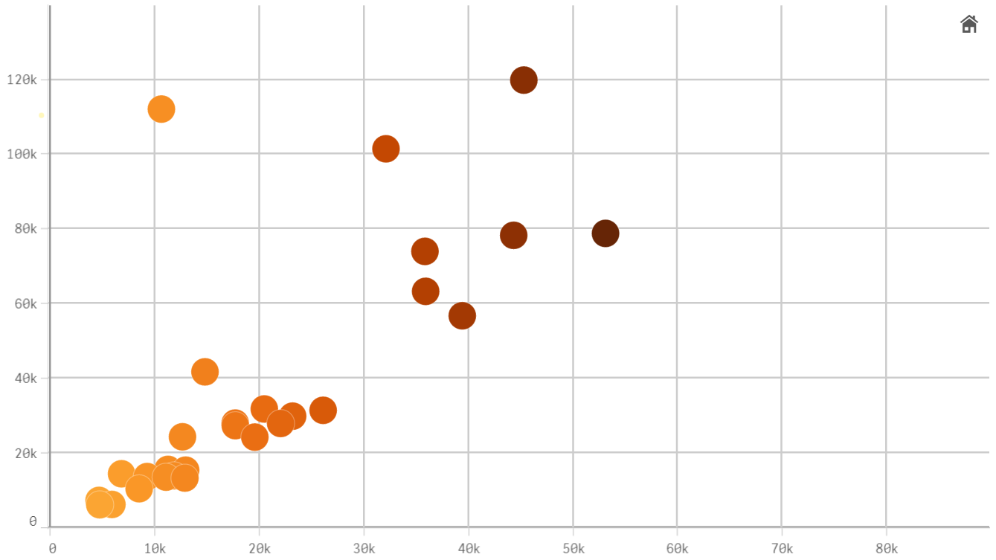
Qlik Sense® basics
Visualisations
Scatter plot
It is best used when you are trying to display the distribution and relationship of a pair variables. The scatter plot helps detect potential relationships between values, and identify outliers in data sets.
Additional information can be illustrated through the size and/or colour of the dots.

Slide 33
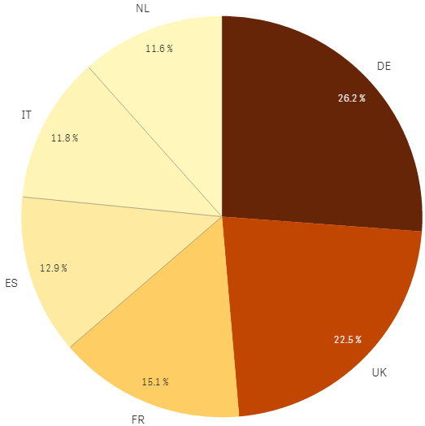
Qlik Sense® basics
Visualisations
Pie chart
It is best used to display proportional data, and/or percentages.
Since the pie chart represents the size relationship between the parts and the entire entity, the parts need to sum to a meaningful whole.
It is best to avoid the pie chart when there are many values as it can easily become cluttered and unreadable.

Slide 34
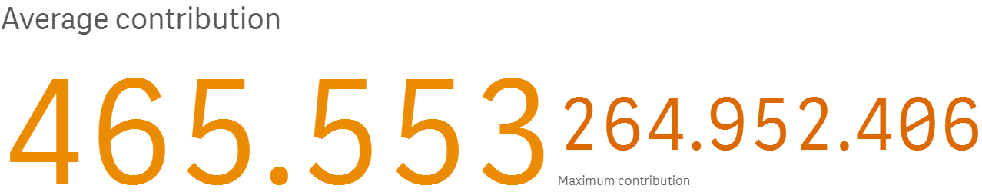
Qlik Sense® basics
Visualisations
KPI – Key Performance Indicator
It displays the state of key variables of an organisation.
It is used to evaluate performance of different metrics in an organisation.

Slide 35
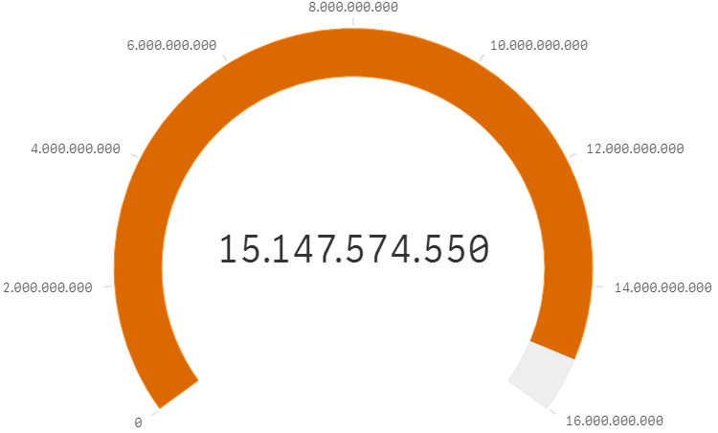
Qlik Sense® basics
Visualisations
Gauge
It is used to indicate the completion of a goal.
The gauge is often used to present KPIs, for example, on an executive dashboard, and together with segmenting and colour coding, it is an effective way of illustrating a performance result.

Slide 36
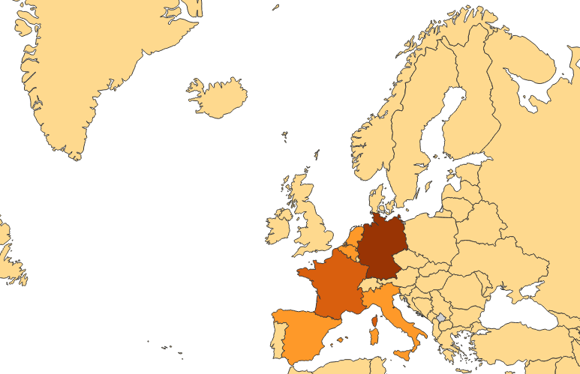
Qlik Sense® basics
Visualisations
Map
It is used to display data as point and or areas on a map.
It is used to display the geographical distribution of variables, such as sales by office, store, city or country around the world.

Slide 37
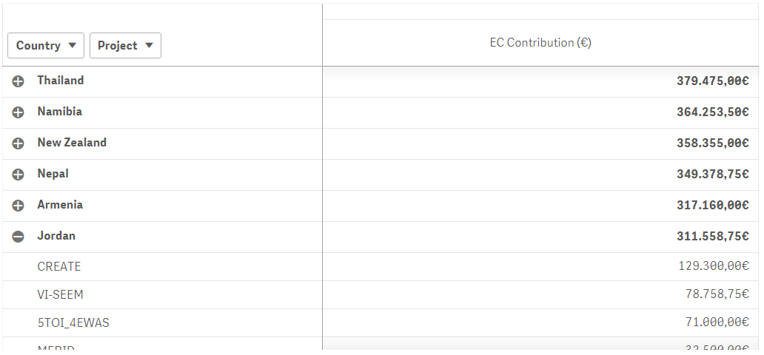
Qlik Sense® basics
Visualisations
Pivot table
It is used to summarise and create a cross table view of data. It is particularly useful when you want to include several dimensions or measures in a single table, and then want to reorganize them to explore different subtotals.
In a pivot table you can analyse data by multiple measures and in multiple dimensions at the same time. You can rearrange the measures and dimensions to get different views of the data.

Slide 38
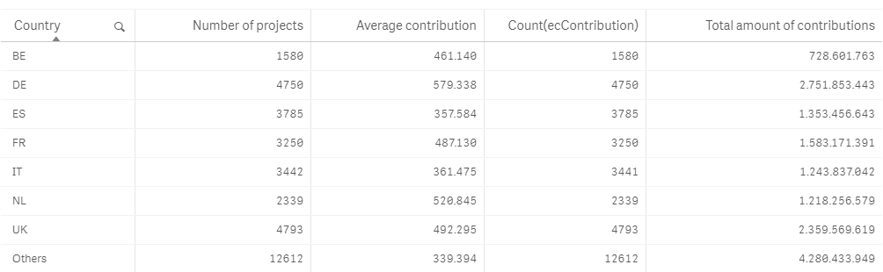
Qlik Sense® basics
Visualisations
Table
It displays values in record form, so that each row of the table displays the fields aligned as in the data source. Fields containing calculated values can also be added.
Use them when you want to view detailed data and precise values rather than visualizations of values.

Slide 39
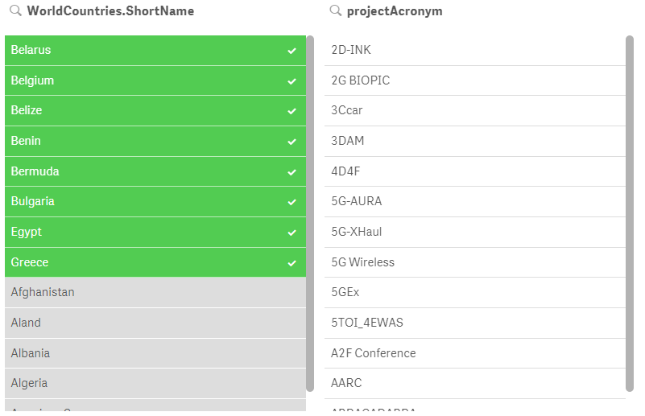
Qlik Sense® basics
Visualisations
Filter pane
Essentially an index to make selections to reduce the dataset by controlling what data is reflected in the visualizations on a sheet.
Multiple filter panes can be combined, to easily make several selections and define your data set exactly like you want it.

Slide 40
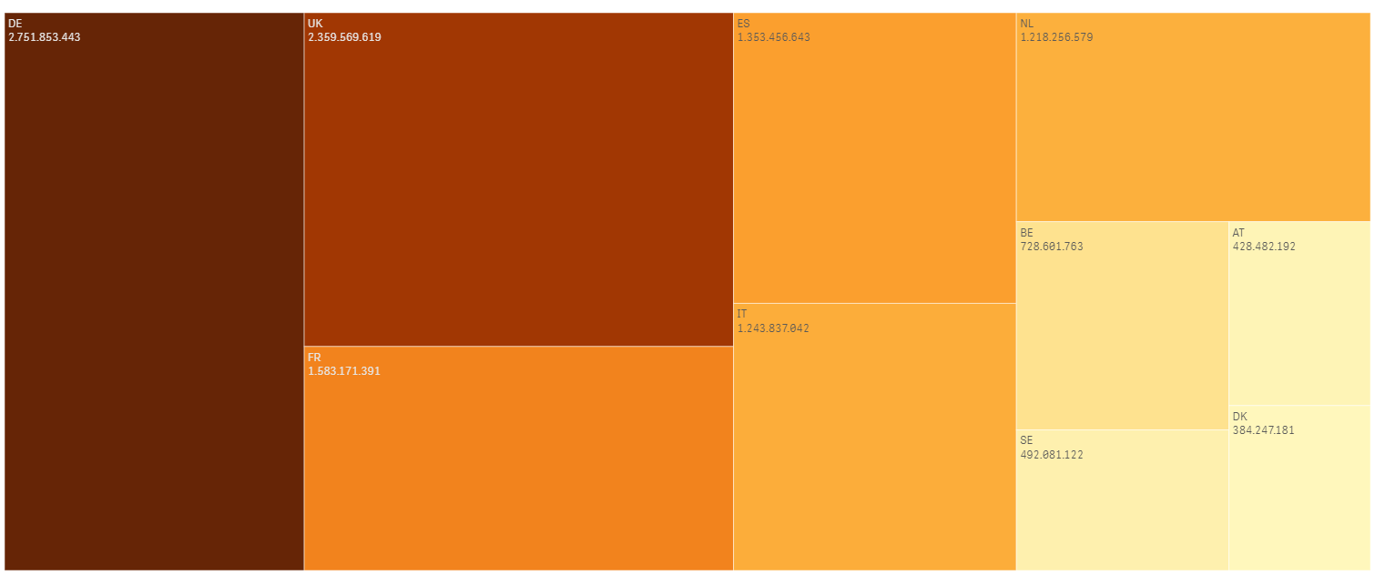
Qlik Sense® basics
Visualisations
Treemap
It is used to display a large amount of hierarchical data within a limited space.
It is great at displaying aggregate data and allowing exploration through drilling down.

Slide 41
Qlik Sense® basics
Functions
Functions are used to manipulate data in apps. There are several hundreds available functions in Qlik Sense® that can be used for various purposes, such as to perform calculations, interpret data, determine conditions etc.
Functions always take their parameter(s) enclosed in parentheses ( ).
An overview can be found:
https://help.qlik.com/en-US/sense/3.1/Subsystems/Hub/Content/Scripting/functions-in-scripts-chart-expressions.htm
Some examples of functions:
  IF ( )
  COUNT ( )
  AGGR ( )
  DATE ( )
  SUM ( )
  AVG ( )
  NUM ( )
  RANK ( )
  RGB ( )
  CYAN ( )

Slide 42
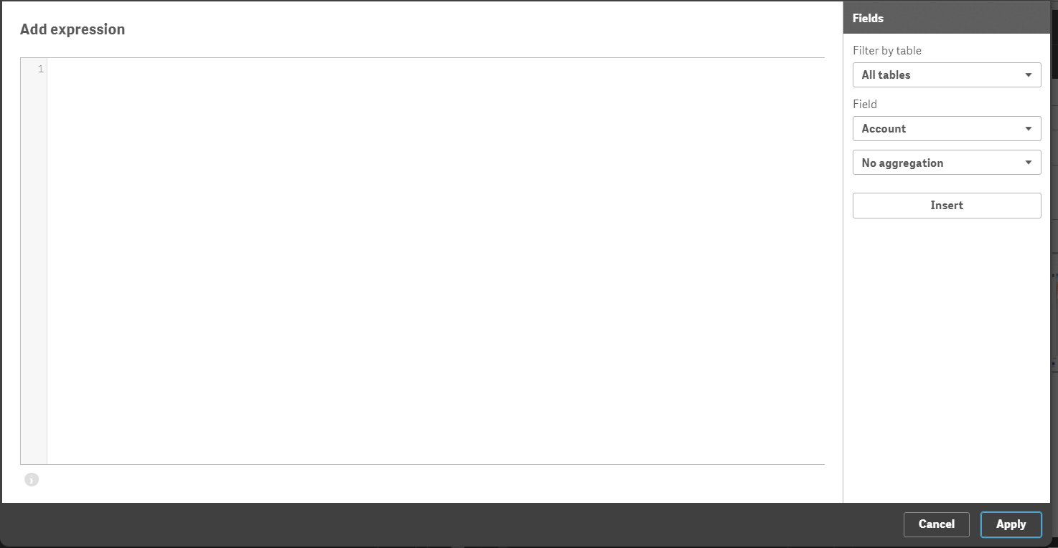

Qlik Sense® basics
Expressions
Expressions are combinations of fields, variables, operators, functions and numbers put together in a structured way to calculate a value.
Expressions are used in scripts and chart visualisations, to manipulate data and/or affect appearance.
The presence of the following icon indicates the possibility to use an expression. It opens the Expression Editor, a handy tool that assists in the creation and debugging of expressions.

Slide 43
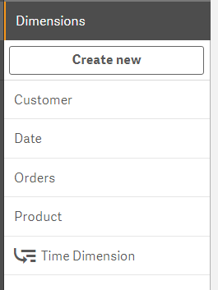
Qlik Sense® basics
Dimensions
Dimensions determine how the data in a visualisation is grouped. In essence they offer the lens through which we break down and explore our data.
For example the dimension will be represented by slices in a pie chart or bars in a bar chart to view the contribution of funds by country or by project.
In Qlik Sense® dimensions are created automatically from the fields in the source data. Additionally custom dimensions can be created.
Dimensions can be single or drill-down

Slide 44
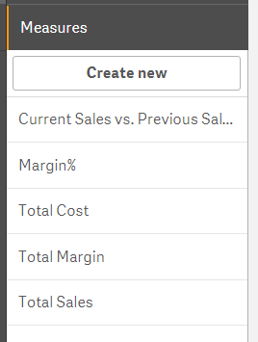
Qlik Sense® basics
Measures
Measures are calculations used in visualizations, typically represented on the y-axis of a bar chart or a column in a table. Measures are created with expressions composed of aggregation functions, such as:
Additionally custom measures can also be created and are a major part of any Qlik project.
    Sum: Calculates the sum of the field’s values for each value of the dimension;
    Avg: Calculates the average of the field’s values for each value of the dimension;
    Count: Calculates the number of values in the field for each value of the dimension;
    Min: Calculates the minimum value of the field for each value of the dimension;
    Max: Calculates the minimum value of the field for each value of the dimension.

Slide 45
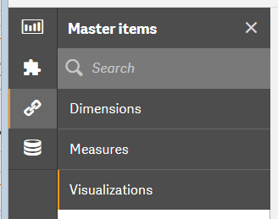
Qlik Sense® basics
Master Items
Master items are customised and reusable assets such as visualizations, dimensions and measures that you can use throughout your app.
You can use a master dimension in as many of your visualizations as you like and maintain it in just one place. Any updates you make to the master item will be applied everywhere the master item is used.
Notes:
Make a comment here on the example of fixing up visualisations with an organisations colours and letting the users reuse them as they wish while retaining the fixed appearance

Slide 46
Qlik Sense® basics
Seeking help
Qlik Sense® online help pages
Always remember there are online help pages that describe most of the features available.
https://help.qlik.com/en-US/sense/3.1/Content/Home.htm
Qlik Sense® Community
Also if something is not documented in the formal documentation it will most probably exist in the forums. This is where you will refer to most often when.
https://community.qlik.com/community/qlik-sense
Tip! When searching google, check out results for Qlik View. Often the answer will also be applicable in Qlik Sense®.
Notes:
Keep in mind that often help you find online relating to Qlik View is also applicable to Qlik Sense

Slide 47
Qlik Sense® user interface

Slide 48
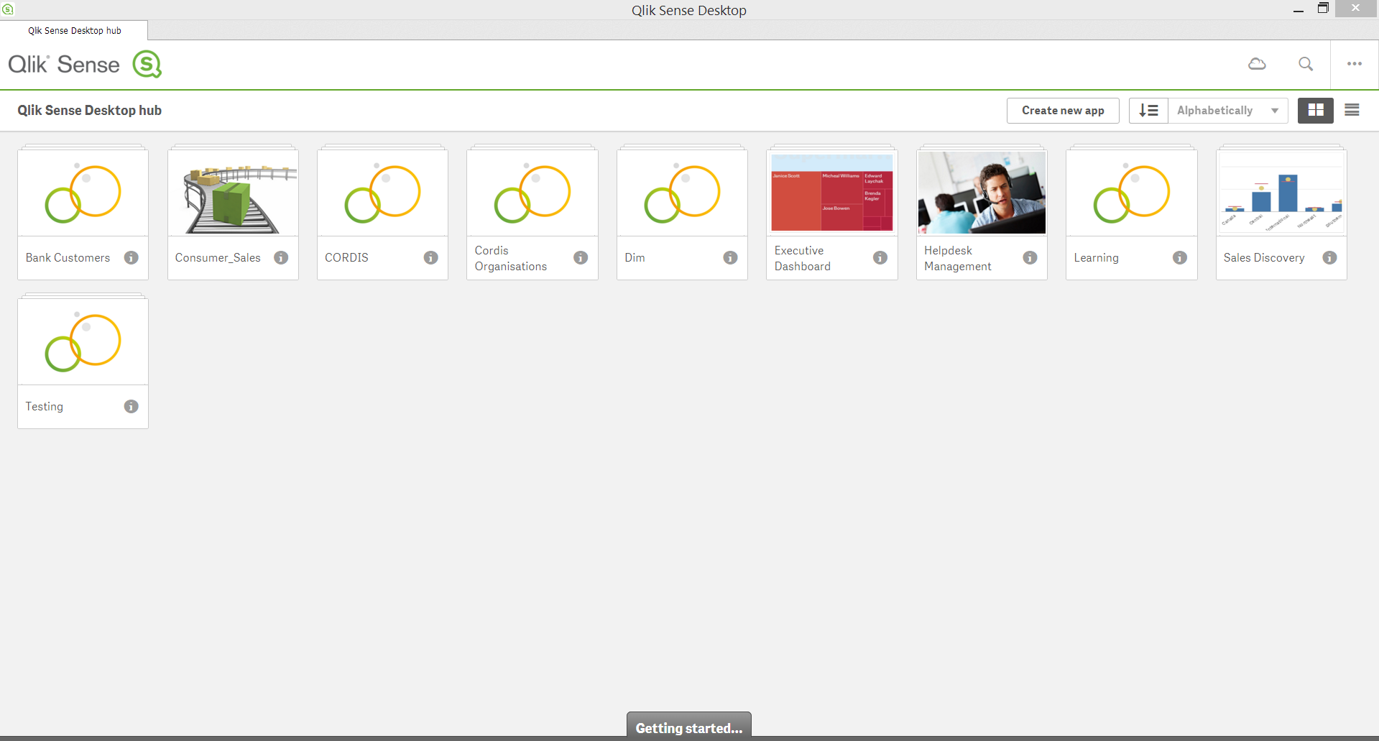
Qlik Sense® user interface
Qlik Sense® Hub
The Qlik Sense® Hub offers an overview of all your apps and is where you create a new one.

Slide 49
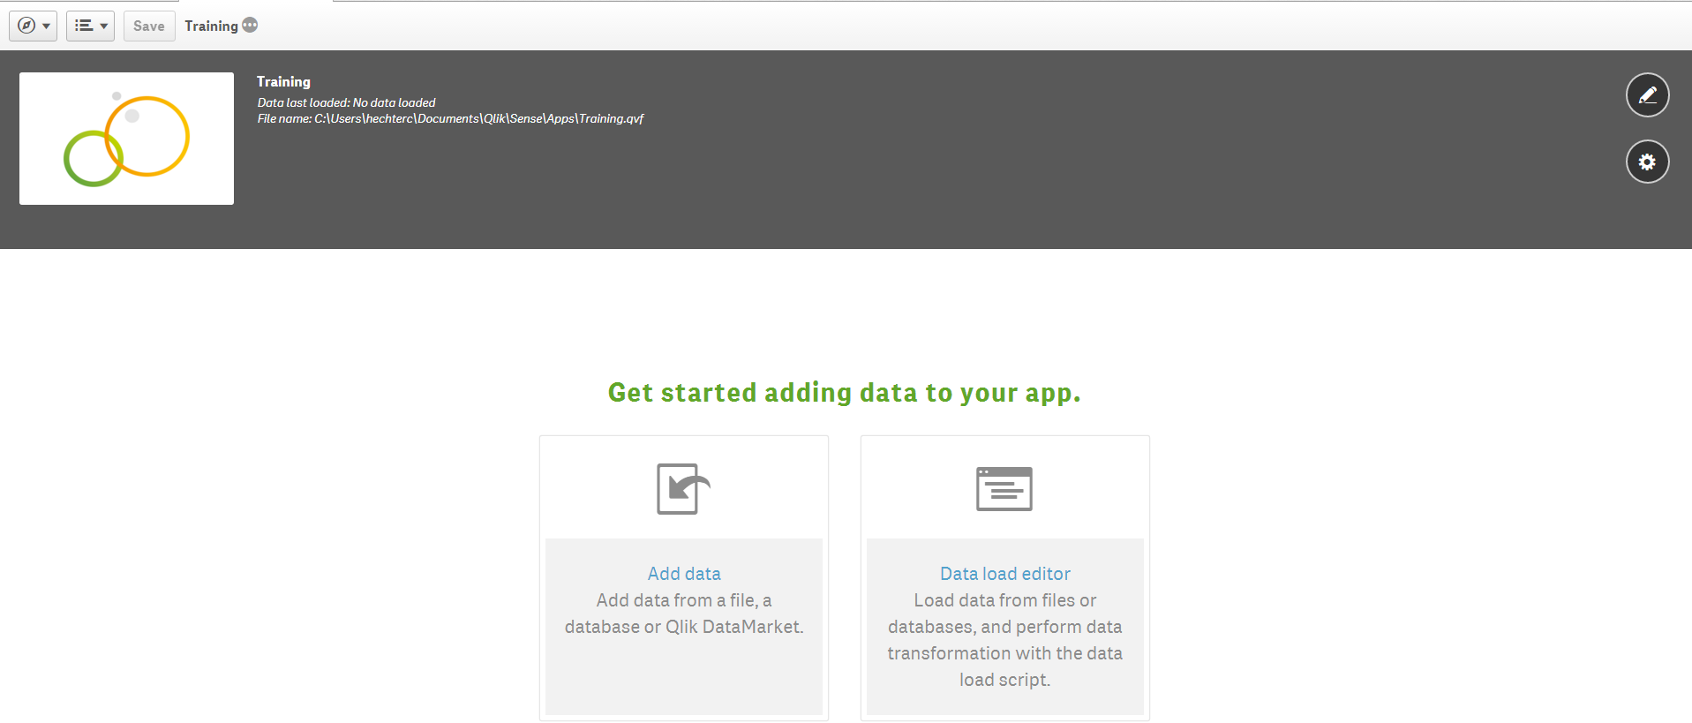
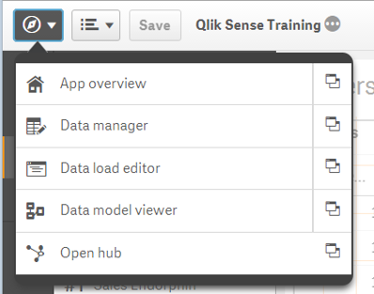
Qlik Sense® user interface
App overview
1 2 3 4
Navigation button, used to navigate between the main interfaces of app creation
The App overview is where you can see all the components of your app.
The Data manager allows you add data to and manage data in Qlik Sense®.
The Data load editor allows more technical users to add data to their app and determine details through a scripting language.
The Data model viewer allows the user to visualise the data sources in his app and the connections between them.
Brings the user back to the Qlik Sense® hub where all the apps are hosted.

Slide 50
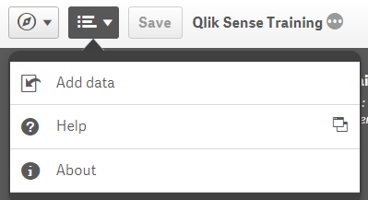
Qlik Sense® user interface
App overview
1 2 3 4
Dropdown menu with three choices: Add data, Help and About.

Slide 51

Qlik Sense® user interface
App overview
1 2 3 4
Save button, also remember to just Ctrl + S from time to time.

Slide 52
Qlik Sense® user interface
App overview
1 2 3 4
The three dots toggle the grey area, either collapsing or expanding it.
“Show app information”

Slide 53
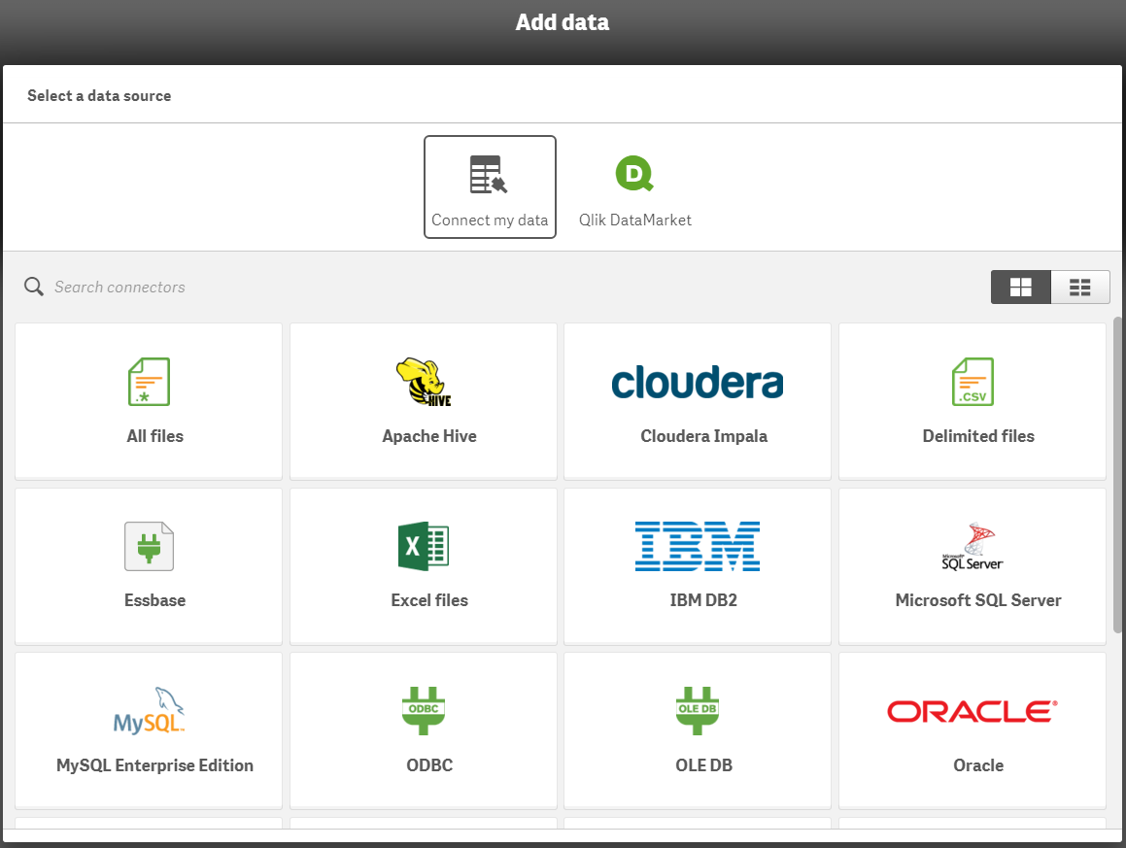
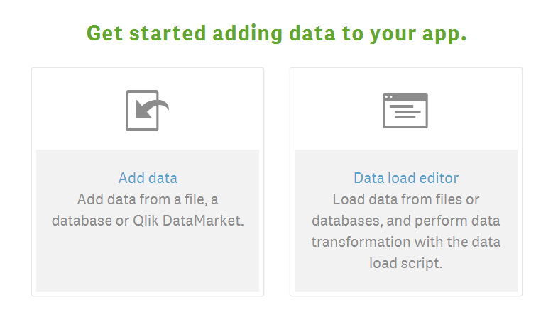
Qlik Sense® user interface
Data addition menu
There are a variety of different options to import data into Qlik Sense®. It is possible to import data locally or from web services.
Text files (CSV or TSV files).
HTML tables.
Excel files
XML files.
Qlik native QVD and QVX files.

Slide 54
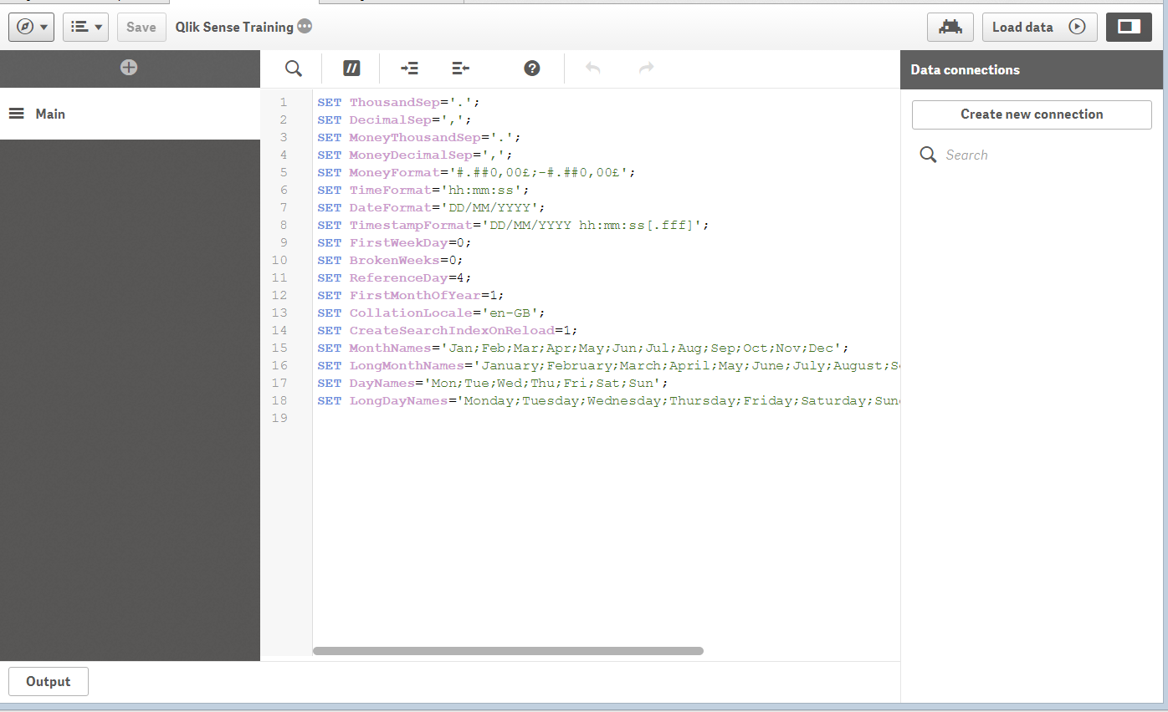
Qlik Sense® user interface
Data addition menu
Data can also be uploaded using the data load editor, writing scripts.

Slide 55
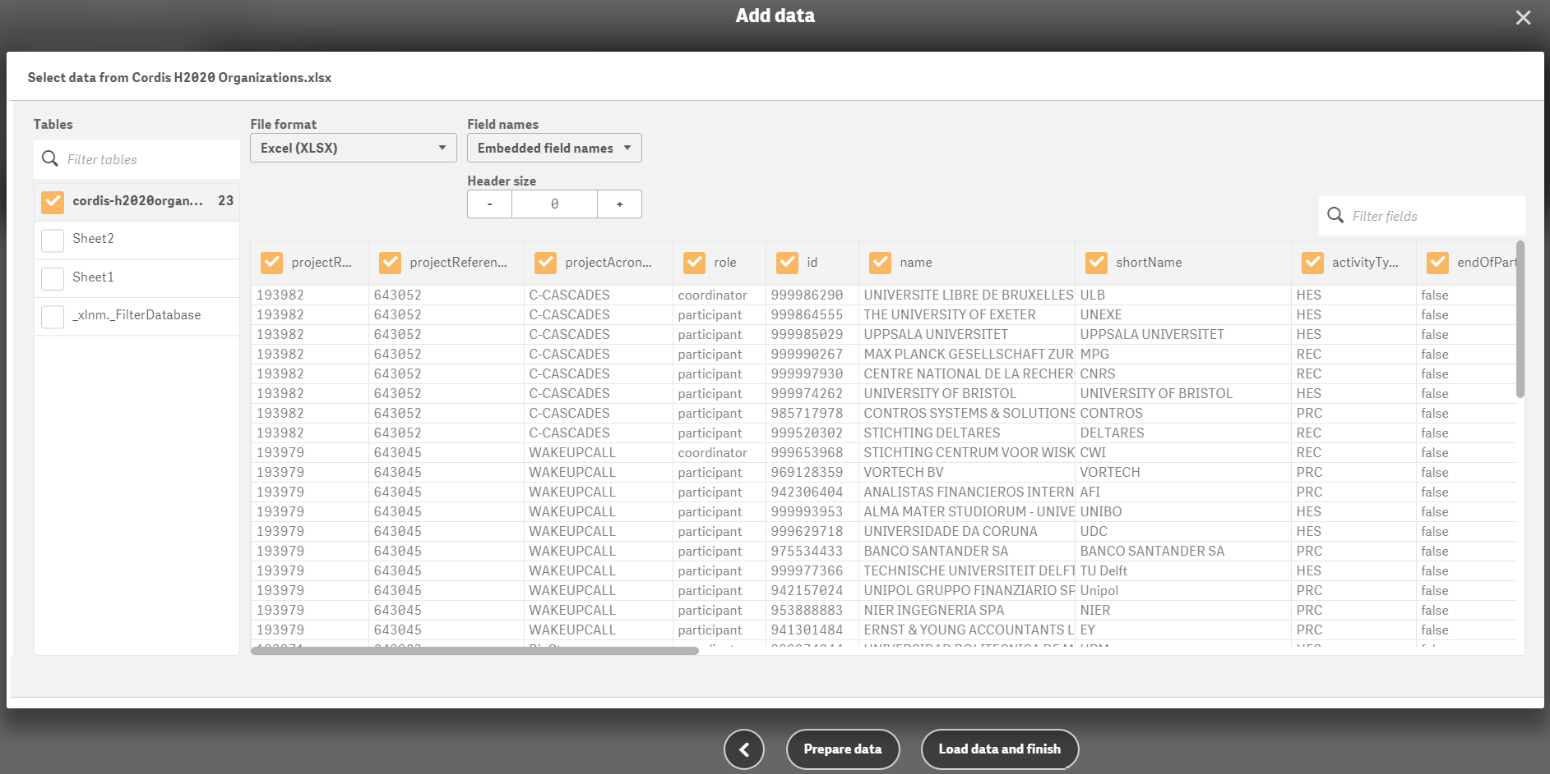
Qlik Sense® user interface
Data preparation menu
From this menu we prepare the data we import to our app.
We can select the columns we need and remove the rest for faster data loading and interaction times;
We can rename the columns to more readable or useful labels;
Finally we can determine the types of the fields imported for optimal analysis.
Notes:
Must check the exact mechanism of the linking feature

Slide 56
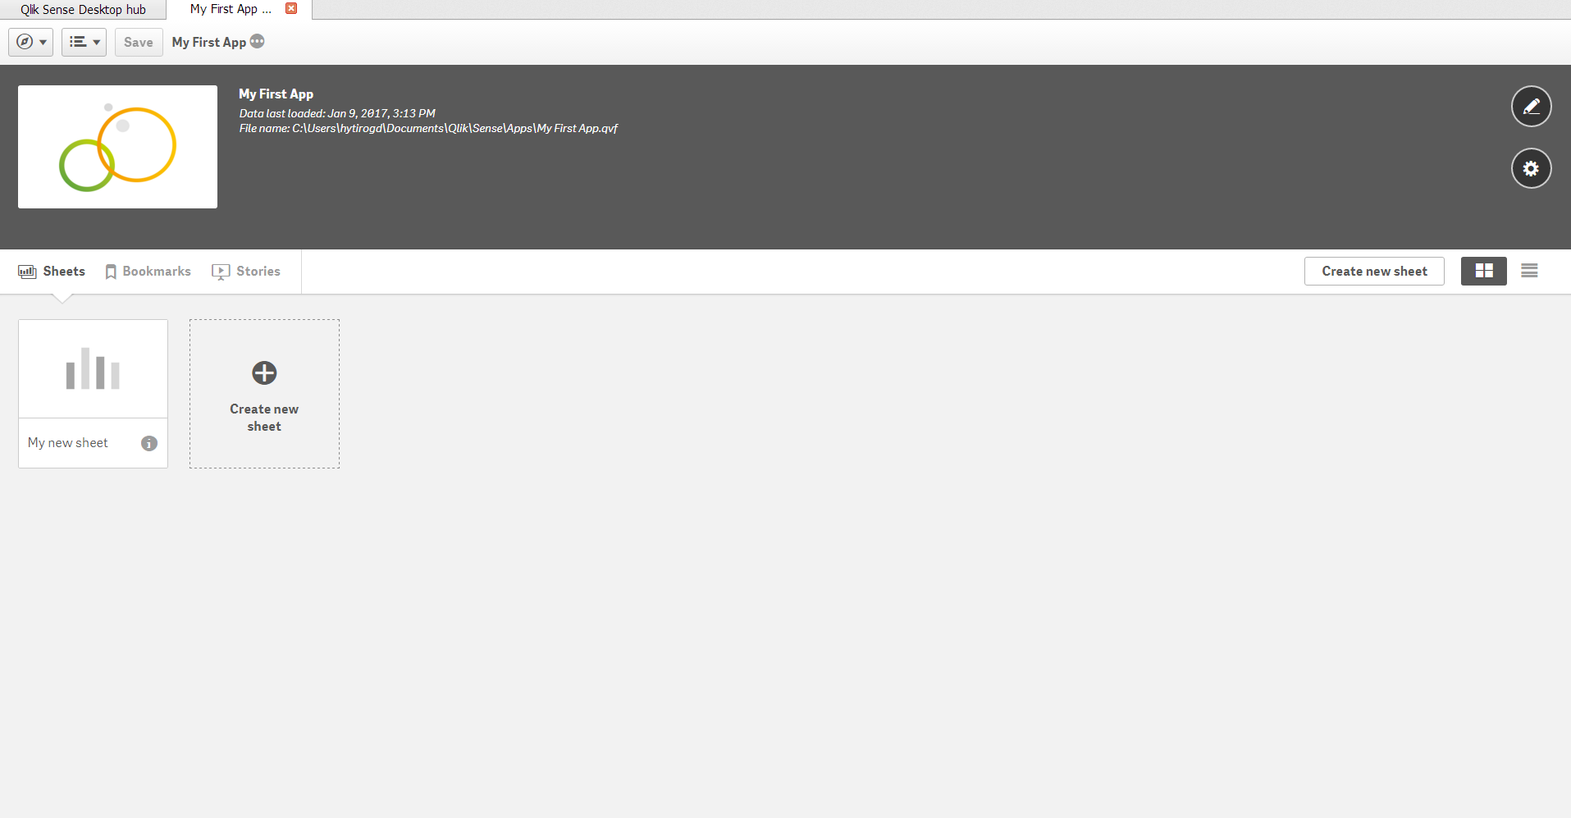
Qlik Sense® user interface
App overview
In the app overview, we can view and edit the contents of our app. These include the sheets, the bookmarks and the stories.
Overview of all sheets in the same app

Slide 57
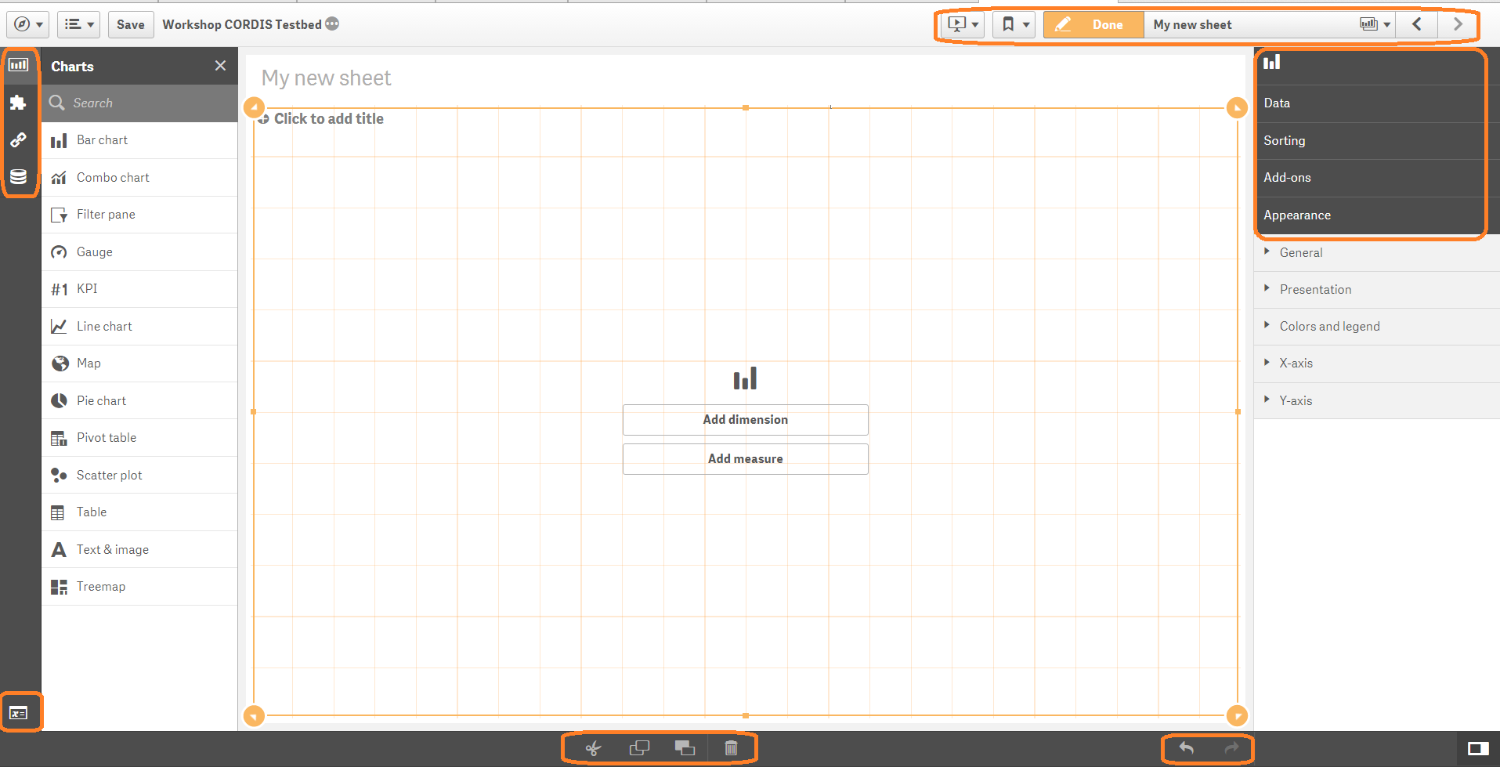
Qlik Sense® user interface
Sheet edit interface
This is where the main work is carried out, that is creating your app’s sheets.
Here you access your Stories, Bookmarks and Sheets, and switch between sheet views;
Here you find your Charts, Custom Items, Master items, fields and variables;
From here you find and edit the properties of the currently selected chart.
Cut, copy, duplicate delete, undo and redo.
1
3
2
4
Notes:
Must check the exact mechanism of the linking feature

Slide 58
Hands on exercise
Visualising CORDIS Data

Slide 59
Hands on exercise
Visualising CORDIS Data
Context
For our first hands on exercise we will create a dashboard using data from the European Commission’s Community Research and Development Information Service (CORDIS).
CORDIS is a portal for information on EU-funded research projects.
For our exercise we will be exploring a dataset containing information on research contributions by the EU to different countries, for different projects under the HORIZON 2020 (H2020) framework programme for research and innovation from 2014 to 2020.
Instructions
During the next slides any text written in black indicates explanations.
Any text written in red indicates actions you need to take for the exercise.

Slide 60
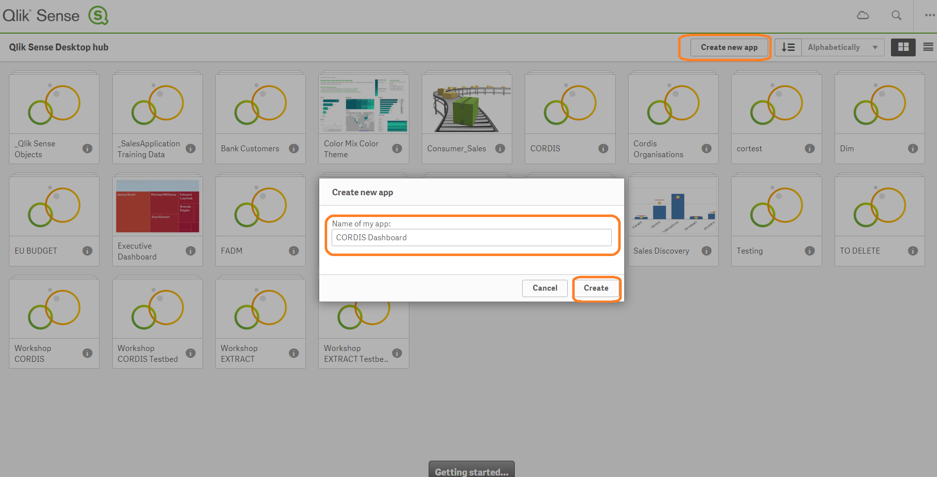
Hands on exercise
Visualising CORDIS Data
Preparing our data
In the Qlik Sense® Hub click on “Create new app” give it a name and click “Create”

Slide 61
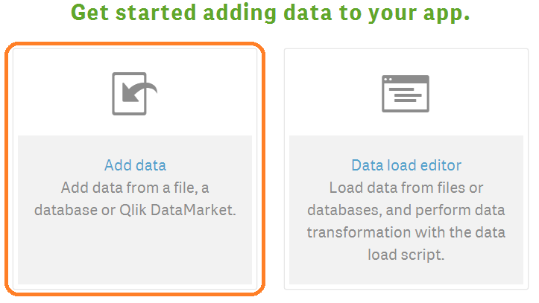
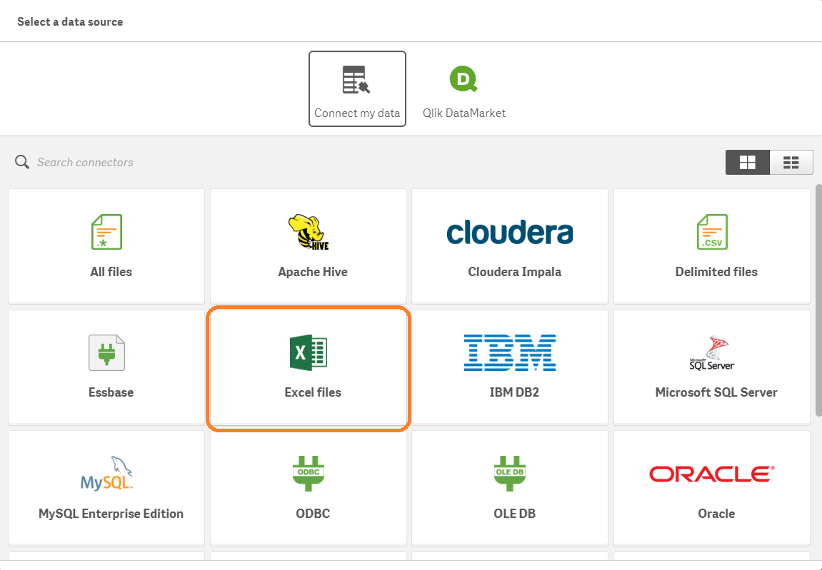
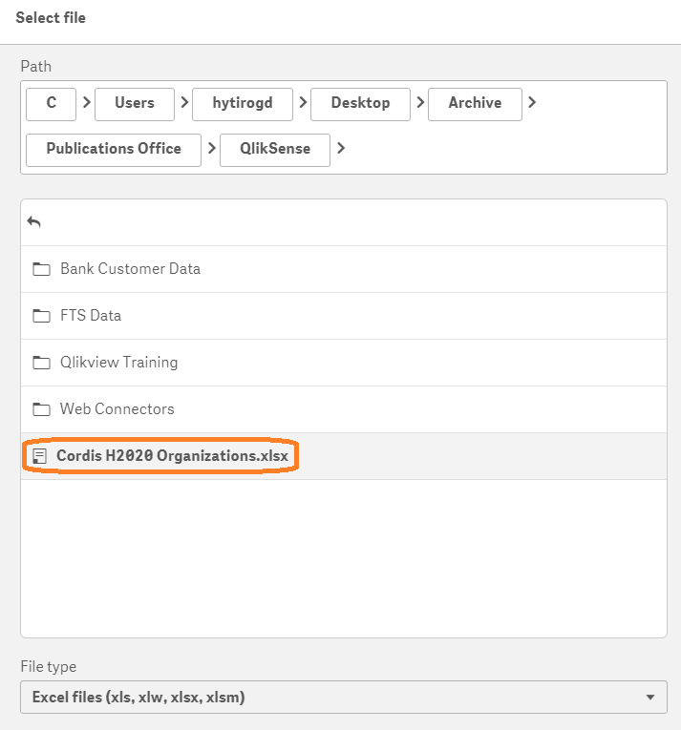
Hands on exercise
Visualising CORDIS Data
Adding our data
Upon opening your empty app you are prompted to add data to it.
  Select “Add data”
  From the next menu choose “Excel files”
  Navigate to the CORDIS H2020 Organisations.xlsx file and select it.
1
2
3

Slide 62
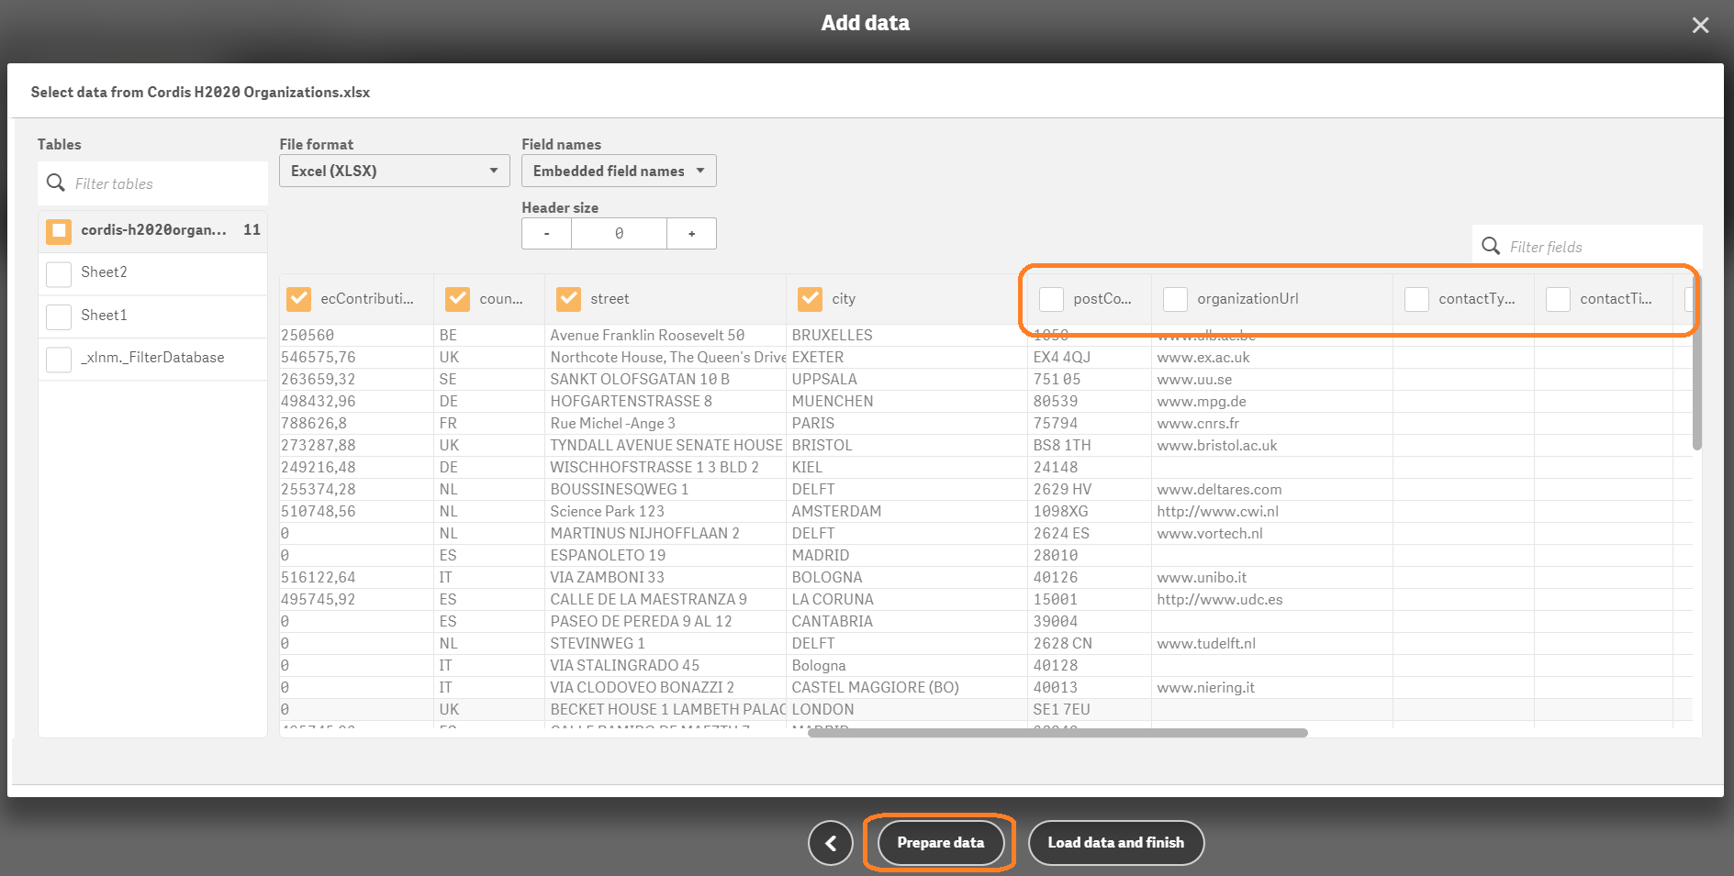
Hands on exercise
Visualising CORDIS Data
Preparing our data
  De-select all the columns after “city” and click “Load data and finish”

Slide 63
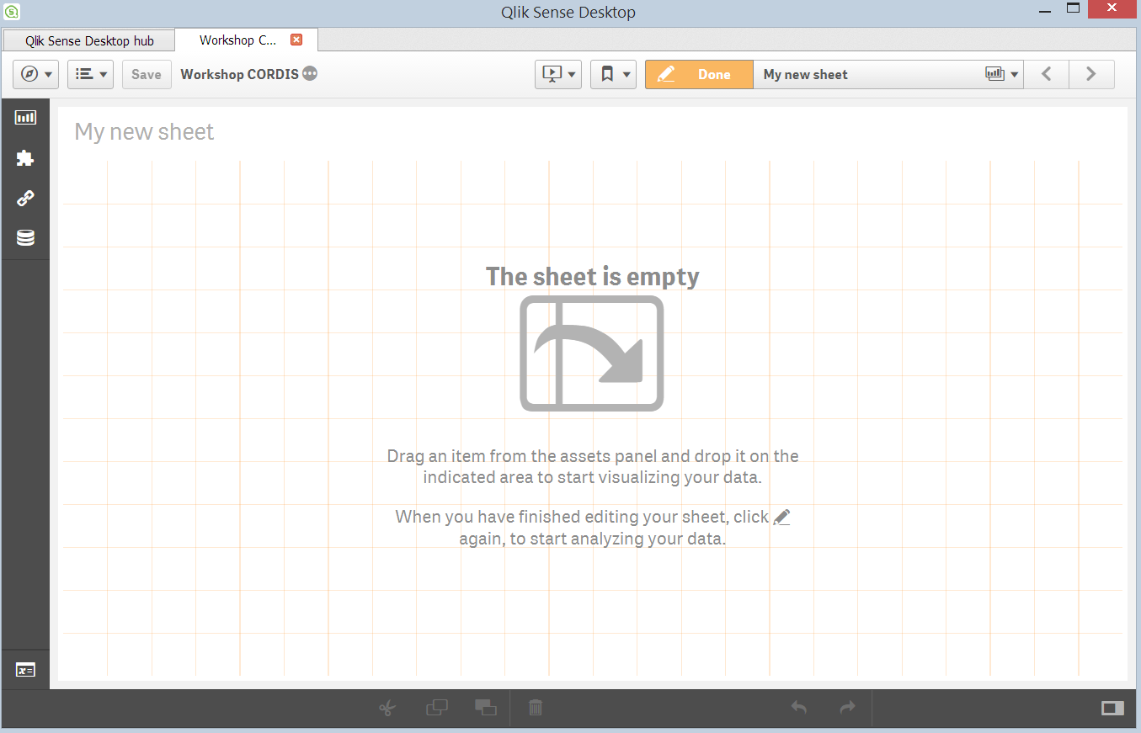
Hands on exercise
Visualising CORDIS Data
Our First Sheet

Slide 64
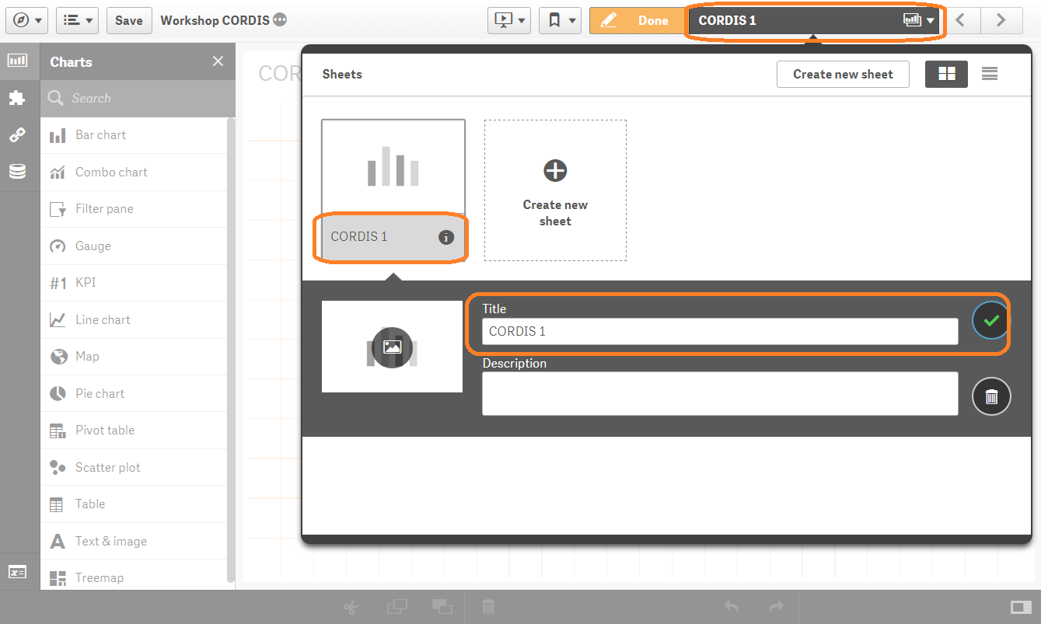
Hands on exercise
Visualising CORDIS Data
Our First Sheet
Click on the sheet name to rename it and to add a description.
For example “CORDIS 1”

Slide 65
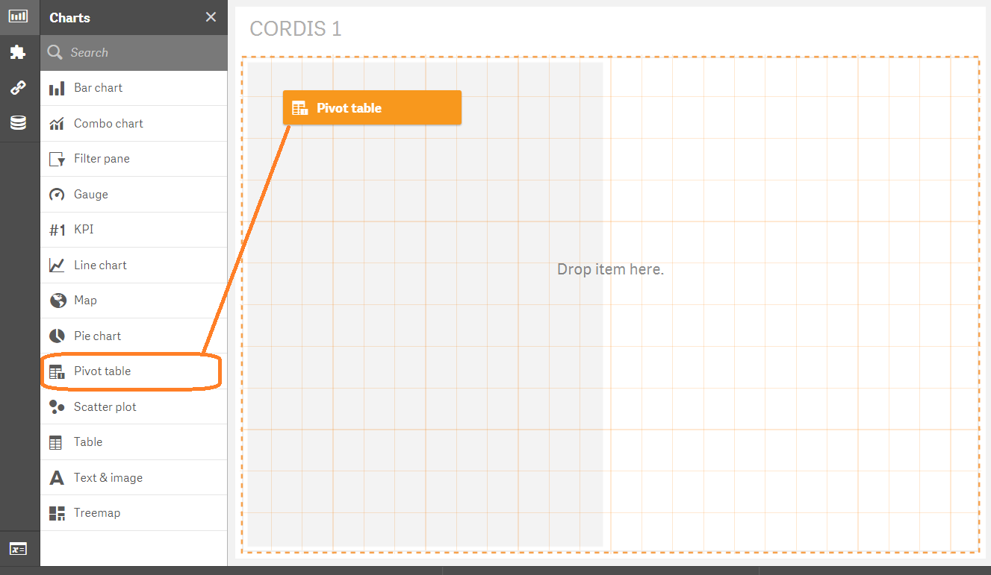
Hands on exercise
Visualising CORDIS Data
Adding a Pivot Table
Drag and drop a “Pivot table” chart from the left onto your sheet.
Notice that when doing so you can move it around to preview the position it will take on your sheet.

Slide 66
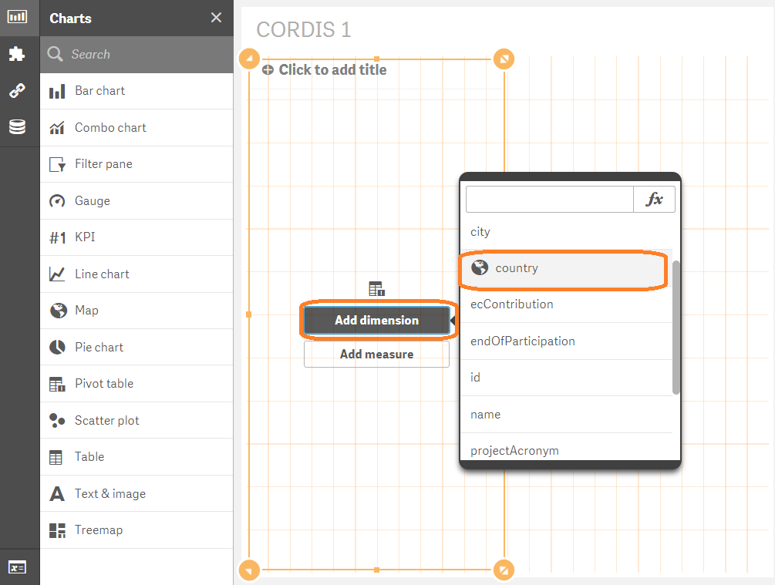
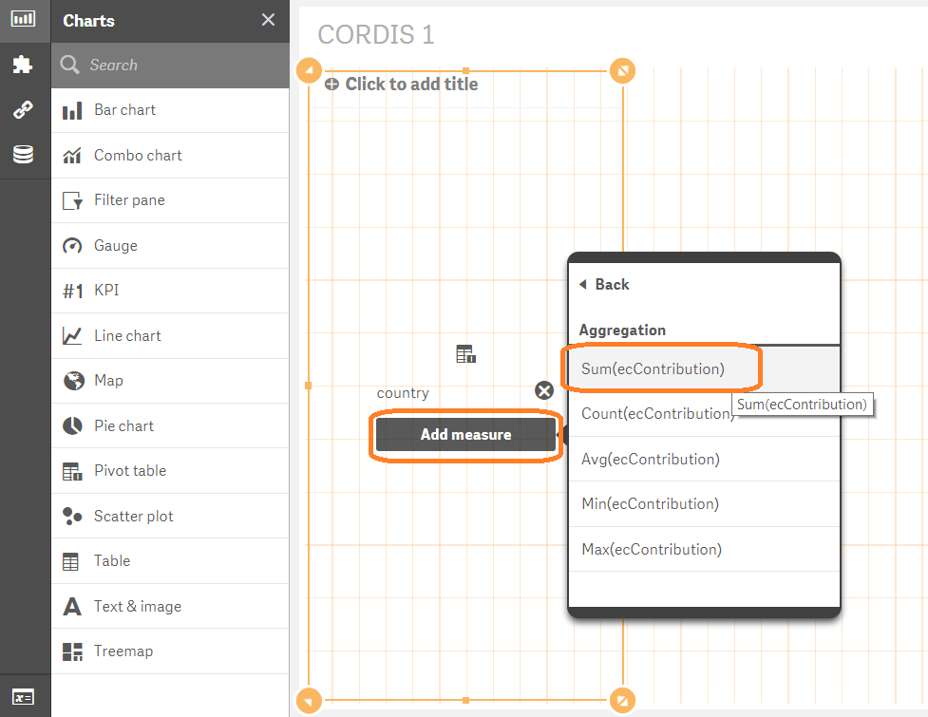
Hands on exercise
Visualising CORDIS Data
Adding a Pivot Table
Add the dimension “country”
Add the measure “Sum(ecContribution)”

Slide 67
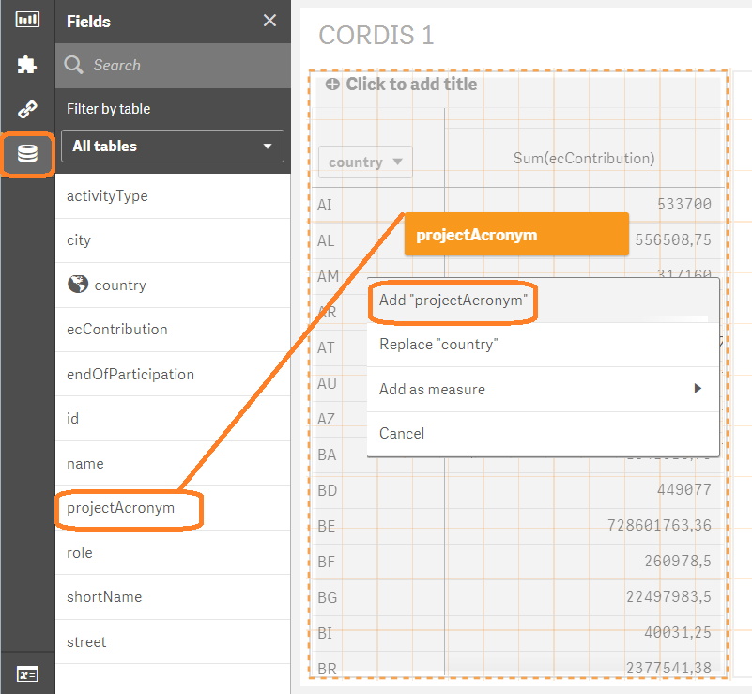
Hands on exercise
Visualising CORDIS Data
Adding a Pivot Table
OK now let’s add another dimension to our pivot table.
Drag “ProjectAcronym” on to your pivot table from the “Fields” menu.

Slide 68
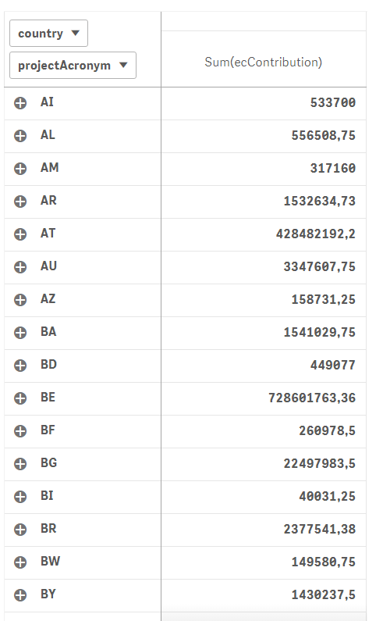
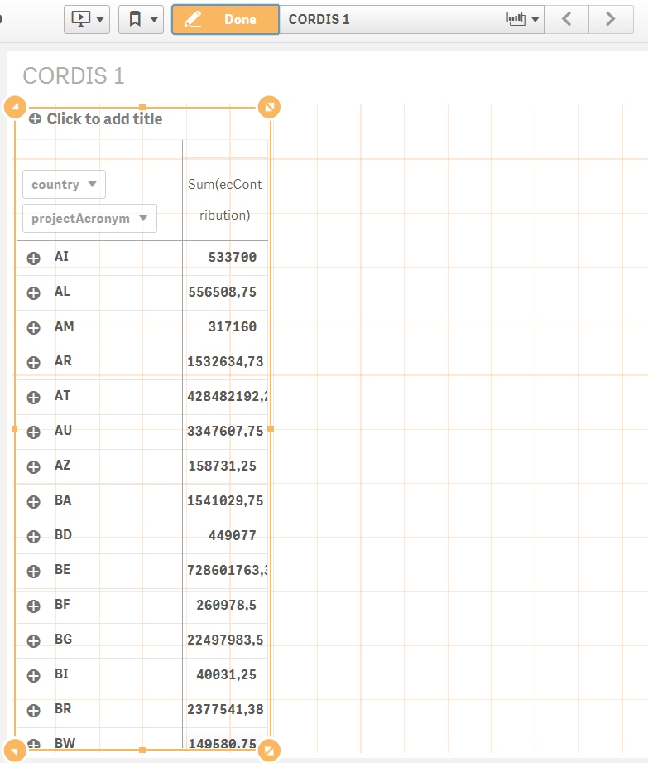
Hands on exercise
Visualising CORDIS Data
Adding a Pivot Table
Now let’s Fix the appearance of our pivot table.
Using the anchors to make the pivot table the narrowest possible while still displaying both columns.
Then click on the Done button to view your sheet as it will be displayed when in use.
Notice the difference of appearance between the “edit” menu and the actual “preview”

Slide 69
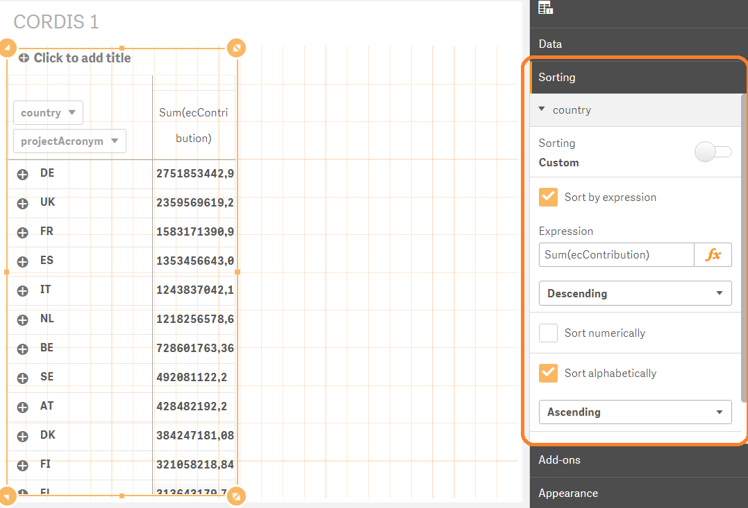

Hands on exercise
Visualising CORDIS Data
Adding a Pivot Table
Our pivot table is by default sorted alphabetically, which is not the best option for our case. Let’s sort it by the SUM of the contribution received:
From the “Sorting” menu
de-select “Auto” sorting.
Select “Sort by expression”
Input “Sum(ecContribution)”
Select “Descending”
De-select “Alphabetically”
Do the same for projectAcronym
using "ecContribution"

Slide 70
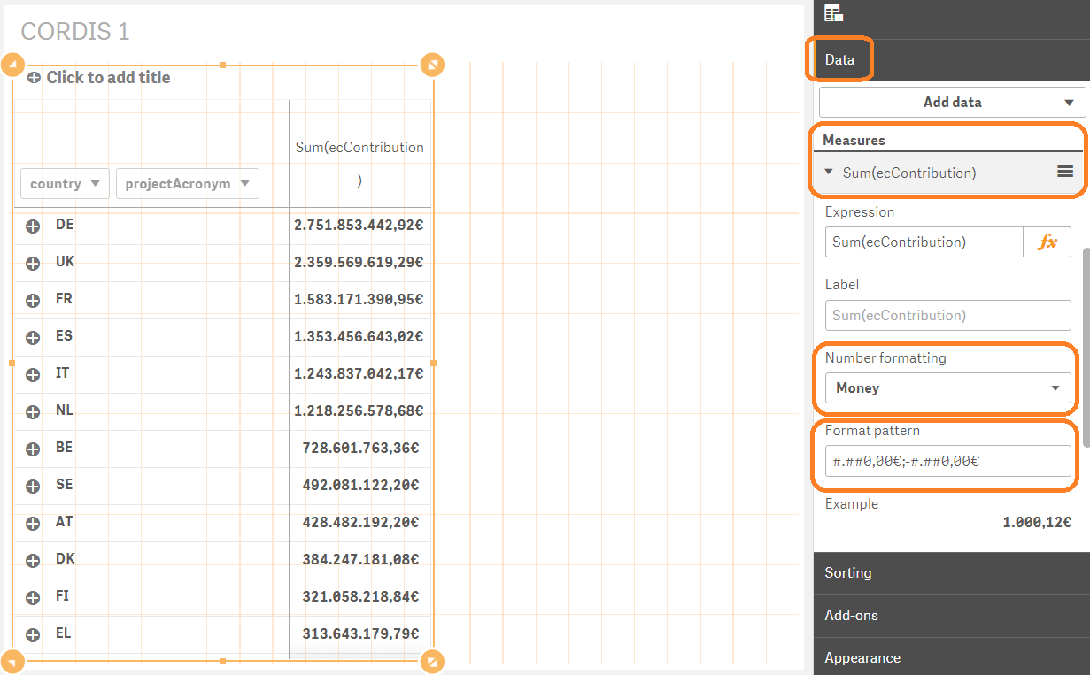
Hands on exercise
Visualising CORDIS Data
Adding a Pivot Table
Another noticeable issue is that the appearance of the values in our table our not consistent.
In the “Data” menu,
under measures,
Sum(ecContibution)
change the number
formatting to “Money”
and format the pattern
to display the values in
euros by replacing the
“£” symbols.
The key for the “€” symbol
should be “Right Alt + E”

Slide 71
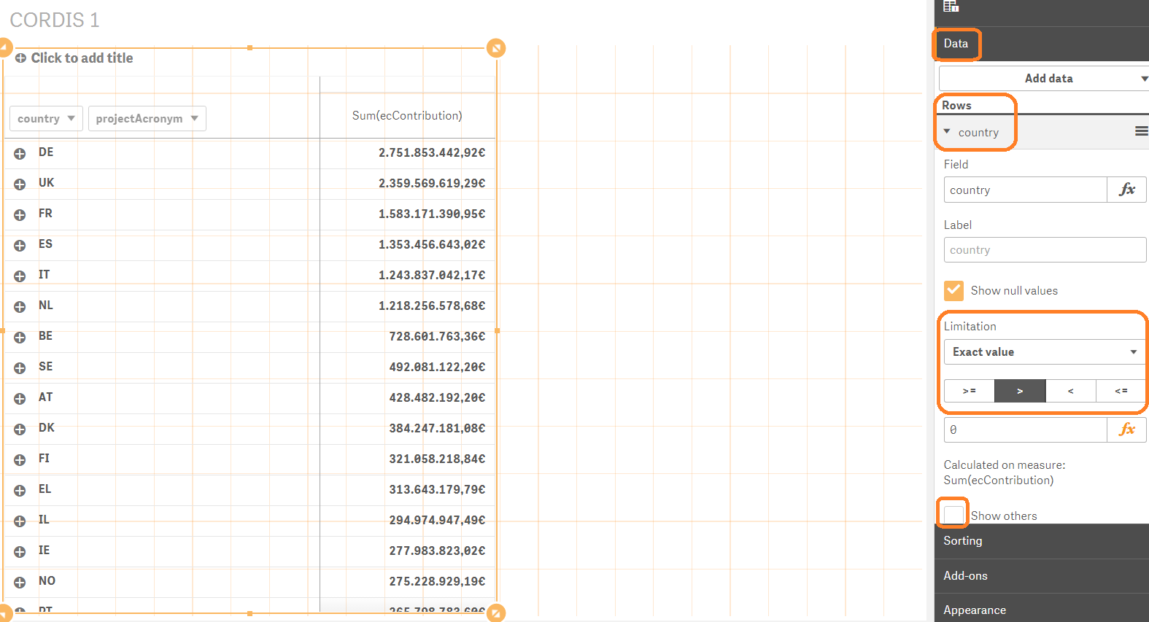
Hands on exercise
Visualising CORDIS Data
Adding a Pivot Table
If you click on “Done” to view the pivot table and scroll through, you will notice that it also lists a number of countries that have received no contributions. We do not need those in our table.
In the “Data” menu,
under rows, under
country:
Add a Limitation of
“Exact value” for values
greater than “0”
Also de-select the
“Show others” button
Repeat the same under
Project.
Notes:
Don’t forget to repeat the steps under project, maybe illustrate what happens if you dont

Slide 72
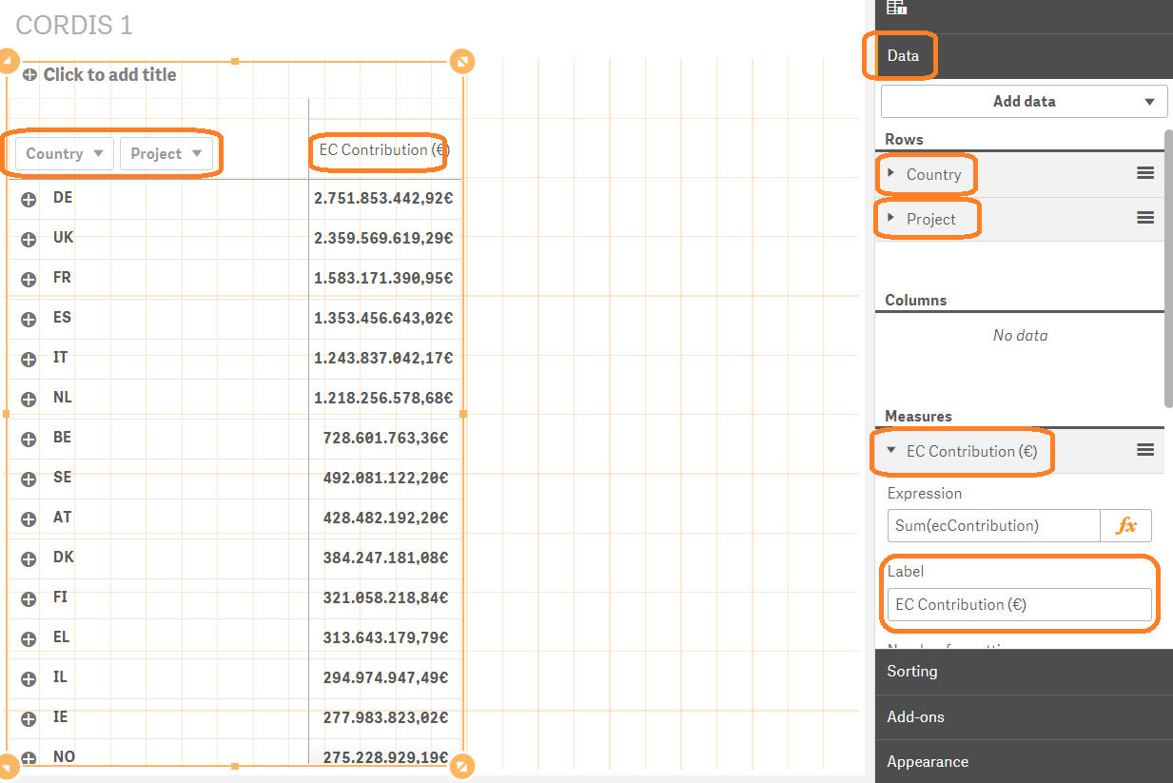
Hands on exercise
Visualising CORDIS Data
Adding a Pivot Table
Finally let’s fix the labels of our table. The row, column and measure labels are auto-generated from the field name. the rest are empty by default.
In the “Data” menu,
go through the rows
and the measure and
make their labels
more human friendly.

Slide 73
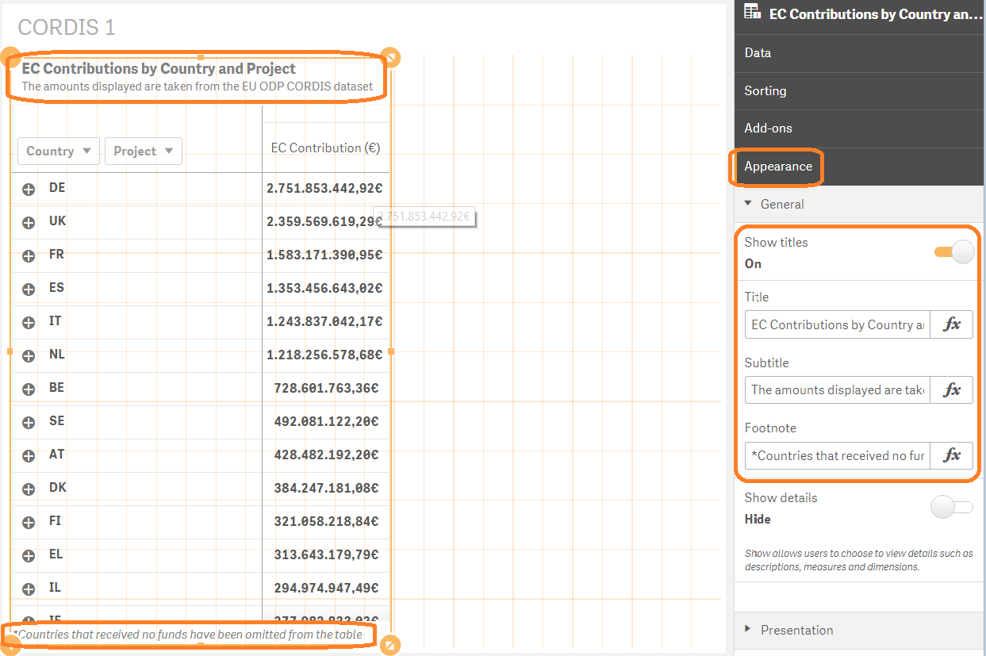
Hands on exercise
Visualising CORDIS Data
Adding a Pivot Table
Finally let’s fix the labels and titles of our table. The row, column and measure labels are auto-generated from the field name. The rest are empty by default.
In the “Appearance” menu,
under “General”, add a
Title, Subtitle and Legend
to better describe your
pivot table.

Slide 74

Hands on exercise
Visualising CORDIS Data
Adding a Bar Chart
OK! Next let’s add a bar chart that will automatically adapt to our choices in the pivot table and help visualise the amounts to better convey their magnitude.

Slide 75


Hands on exercise
Visualising CORDIS Data
Adding a Bar Chart
Add “country” as a dimension
Add “Sum(ecContribution)” as a measure

Slide 76
Hands on exercise
Visualising CORDIS Data
Our first linked interactive visualisation
Click on “Done” to view your sheet in its proper form
Notice how the charts have been automatically linked and both adapt based on selections on either one
There are many ways in which you can explore your data and the more objects you add the more complex the options!
Notes:
HERE SHOW ALL KINDS OF DIFFERENT WAYS TO FILTER THE DATA FROM EITHER OR BOTH THE CHARTS AND BY COUNTRY OR PROJECT

Slide 77

Hands on exercise
Visualising CORDIS Data
Adding a Bar Chart
Let’s refine our bar chart and go on to the next part of our sheet.
Add a title
Remove the Y Axis Title as its redundant
Make the Y Axis scale narrower
Notes:
Add a title
Fix the Labels
Format as Money (€), Remove decimals OR Maybe leave as Auto as we have the detailed number in the pivot table (explain pros and cons here)
Make the Y Axis scale narrower, keep only the label for simplicity as the title is self explanatory
Show how you can add “value labels to the chart”
Show you can keep the top 30 etc
Show you an slant the labels of the countries
Show color gradient but say how it doesn’t add to anything at the moment

Slide 78

Hands on exercise
Visualising CORDIS Data
Adding a Map
It’s time for everyone’s favourite chart, the map!
Maps require special “Shape” data to define the locations. This data includes coordinates that outline areas and pinpoint locations.
We have provided you with just that.
Open your “Data manager”
in a new tab.

Slide 79

Hands on exercise
Visualising CORDIS Data
Adding a Map
In the Data manager click on the little cross on the right, to add a data source.

Slide 80

Hands on exercise
Visualising CORDIS Data
Adding a Map
Navigate to and select the “WorldKMLData.qvd” file. Click next.

Slide 81

Hands on exercise
Visualising CORDIS Data
Adding a Map
From the selection menu de-select the “WorldCountries.FullName” and “CountryISO_Numeric” as we won’t need them.
Then click “Load data and finish”.

Slide 82

Hands on exercise
Visualising CORDIS Data
Adding a Map
We are now in the associations menu. In this menu we can link different data sources based common data fields.
Each bubble represents a different data source.

Slide 83

Hands on exercise
Visualising CORDIS Data
Adding a Map
Drag and drop the “WorldKMLData” bubble onto the “CORDIS” bubble to create an association.

Slide 84

Hands on exercise
Visualising CORDIS Data
Adding a Map
On doing so, notice that Qlik Sense automatically detects that there are common values between the country code fields of the two data sources.
The orange colour indicates a medium level of common values. This can also be green, for a very good match, or red, for no match at all.

Slide 85

Hands on exercise
Visualising CORDIS Data
Adding a Map
Click on the association name and rename it to “Country” for simplicity.
Then click on “Load data”, at the top right corner to include the new data in your app.
Notes:
Imagine that you have now replaced the “country” and “CountryISO_2Char” fields with a single common field between the 2 data sources and is named “Country” with a capital “C”

Slide 86

Hands on exercise
Visualising CORDIS Data
Adding a Map
We will also add some country population data to use later on.
Navigate to and select the “WorldPopulations.xls” file. Click next.

Slide 87

Hands on exercise
Visualising CORDIS Data
Adding a Map
Drag the populations source on to the WorldKMLData source.
Create an association between the “CountryISO_3Char” and the “Country Code” fields and rename it “Country ISO3”.
Then click on “Load data”, at the top right corner to include the new data in your app.
Notes:
Imagine that you have now replaced the “country” and “CountryISO_2Char” fields with a single common field between the 2 data sources and is named “Country” with a capital “C”

Slide 88

Hands on exercise
Visualising CORDIS Data
Adding a Map
Upon returning to your sheet, notice that the charts display errors now. This is because now there is an error with a dimension, as we renamed a field name “country’ to “Country”.
Simply update the field and your charts will pop back.
Notes:
Imagine that you have now replaced the “country” and “CountryISO_2Char” fields with a single common field between the 2 data sources and is named “Country” with a capital “C”

Slide 89

Hands on exercise
Visualising CORDIS Data
Adding a Map
Now let’s add the map to our datasheet.
Drag and drop the “Map” chart onto the top right corner of your sheet.

Slide 90

Hands on exercise
Visualising CORDIS Data
Adding a Map
Find the “Country” field in the “Fields” menu under “WorldKMLData” and drag and drop it onto the map chart.

Slide 91

Hands on exercise
Visualising CORDIS Data
Adding a Map
Find the “WorldCountries.ShortName” field in the “Fields” menu under “WorldKMLData” and drag and drop it onto the map chart. Select “Add as area layer”.

Slide 92

Hands on exercise
Visualising CORDIS Data
Adding a Map
Next we must add the contribution data to our map.
Drag and drop ecContribution onto the map and select “Color by” -> “By measure” -> “Sum(ecContribution)”

Slide 93

Hands on exercise
Visualising CORDIS Data
Adding a Map
The result should look somewhat like this.
Notes:
By the way notice that the name of the country is displayed fully as we used the “ShortName” field to create the areas on the map. However the connection between the “ShortName” and “ecContribution” fields is done through the now common “Country” field.

Slide 94

Hands on exercise
Visualising CORDIS Data
Adding a Map
Now when navigating to the “Done” view and selecting the UK on the map, we see that the amount is “0”. Obviously this should not occur. When checking other countries we note that it is the same for Greece and is due to the use of a different country code between the EC, used in CORDIS, and the international ISO-2 specification, used in the WorldKMLData file.

Slide 95

Hands on exercise
Visualising CORDIS Data
Adding a Map
This is a great opportunity to demonstrate one of the most versatile features of Qlick Sense, the “Data load editor” and do some scripting.
Click on the “Navigation” button and open the “Data load editor” in a new tab.

Slide 96

Hands on exercise
Visualising CORDIS Data
Adding a Map
Head to the “Auto-generated section” and click “Unlock” and again “Unlock”.
Here we have automatically generated parameters indicating how to interpret the data contained in our data sources. Notice the purple text indicating our two sources.

Slide 97

Hands on exercise
Visualising CORDIS Data
Adding a Map
We need to modify the way Qlik Sense® loads the data of our “CountryISO_2Char” field, to conform with the code used by the EC.
Modify the line as shown below and click “Load data”.

Slide 98
Hands on exercise
Visualising CORDIS Data
Adding a Map
We need to modify the way Qlik Sense® loads the data of our “CountryISO_2Char” field, to conform with the code used by the EC.
Modify the line as shown below and click “Load data”.
CODE:
if([CountryISO_2Char]='GR','EL',if([CountryISO_2Char]=
'GB','UK',[CountryISO_2Char])) AS [Country]

Slide 99


Hands on exercise
Visualising CORDIS Data
Adding a Map
Going back to your sheet, the UK and Greece should now both display a value.

Slide 100

Hands on exercise
Visualising CORDIS Data
Adding a Map
Now that we have our data working, let’s finalise the appearance of our map.
Add a title, remove the legend and position it at the right in a square shape.

Slide 101

Hands on exercise
Visualising CORDIS Data
Adding a Gauge
Now we will add a gauge to sum up our selections and display the part of total we have gathered. Drag and drop the gauge chart onto your sheet.

Slide 102


Hands on exercise
Visualising CORDIS Data
Adding a Gauge
Add the measure “ecContribution” to your gauge.

Slide 103

Hands on exercise
Visualising CORDIS Data
Adding a Gauge
Now let’s refine our gauge according to our purpose.
From the Measures menu, under data, format the values to appear in “€” and without decimals.

Slide 104

Hands on exercise
Visualising CORDIS Data
Adding a Gauge
Now let’s refine our gauge according to our purpose.
From the Appearance menu, under presentation, add a range limit of
Max=15519180429 as that is
the total amount of
contributions.
Also format for “Labels
only” and a “Wide” scale.
Finally add a title.

Slide 105

Hands on exercise
Visualising CORDIS Data
Adding a Logo
Now let’s add a finishing touch to our sheet.
Drag and drop a “Text & image” chart onto your sheet.

Slide 106
Hands on exercise
Visualising CORDIS Data
Adding a Logo
Head to the following path in your computer:
C:\Users\<user>\Documents\Qlik\Sense\Content\Default
Copy and paste into this folder a file of your choice from the collection of European Commission logos.

Slide 107

Hands on exercise
Visualising CORDIS Data
Adding a Logo
Click on the cross and from the menu that appears click on the image icon at the right.

Slide 108

Hands on exercise
Visualising CORDIS Data
Adding a Logo
Find the logo you added in the default folder and click “Insert”.

Slide 109

Hands on exercise
Visualising CORDIS Data
Adding a Logo
Finally, now that we have our new data including country names we can make them appear in our pivot table as well, making it more readable. Select it and change the field to “WorldCountries.ShortName” and de-select “Show null values”.
Remember! Each name is still connected with the correct contribution value through the common “Country” field.

Slide 110

Hands on exercise
Visualising CORDIS Data
First sheet done!
Click on “Done” and admire your first sheet. Congratulations!
Notes:
Here highlight all the different kinds of exploring we can do through this dashboard.
Illustrate live by doing.
e.g. by selecting a Project we can immediately see how much money was contributed through it and in which countries and compare

Slide 111
Hands on exercise
Visualising CORDIS Data
Shifting perspective
However! There is a slight issue with this sheet. As we by now all agree, visualisations can be misleading. In this case and particularly due to the map and bar chart, one could come to the conclusion that certain countries are granted an uneven amount of funds. But is this really the case..?
Notes:
Here highlight all the different kinds of exploring we can do through this dashboard.
Illustrate live by doing.
e.g. by selecting a Project we can immediately see how much money was contributed through it and in which countries and compare

Slide 112

Hands on exercise
Visualising CORDIS Data
Shifting perspective
By selecting just the 4 top countries we are already get over 50% of the total contributions.
Notes:
Here highlight all the different kinds of exploring we can do through this dashboard.
Illustrate live by doing.
e.g. by selecting a Project we can immediately see how much money was contributed through it and in which countries and compare

Slide 113
Hands on exercise
Visualising CORDIS Data
Shifting perspective
This is a very good example of “shifting the perspective” and changing the lens through which we view a matter.
Be aware that the viewer may not always have all information necessary to fully understand the context. Still as an analyst of the data it is important to gather the correct insights into the data.
So to illustrate the importance of different perspectives on the same data, let us add the population per country into the mix and view the same information per capita!
This should provide us with different insights.
Notes:
Here highlight all the different kinds of exploring we can do through this dashboard.
Illustrate live by doing.
e.g. by selecting a Project we can immediately see how much money was contributed through it and in which countries and compare

Slide 114

Hands on exercise
Visualising CORDIS Data
Shifting perspective
Open your sheets menu, right-click on your first sheet and select “Duplicate”.
Rename the duplicate sheet to “CORDIS per Capita” and open it.
Notes:
Here highlight all the different kinds of exploring we can do through this dashboard.
Illustrate live by doing.
e.g. by selecting a Project we can immediately see how much money was contributed through it and in which countries and compare

Slide 115

Hands on exercise
Visualising CORDIS Data
Shifting perspective
Select the Barchart and modify the fields of its “Data” menu accordingly.
Also change the barchart’s and the gauge’s colour to green to differentiate from the other sheet.
Notes:
Here highlight all the different kinds of exploring we can do through this dashboard.
Illustrate live by doing.
e.g. by selecting a Project we can immediately see how much money was contributed through it and in which countries and compare

Slide 116

Hands on exercise
Visualising CORDIS Data
Shifting perspective
Select the Map and modify the colouring option accordingly.
Notes:
Here highlight all the different kinds of exploring we can do through this dashboard.
Illustrate live by doing.
e.g. by selecting a Project we can immediately see how much money was contributed through it and in which countries and compare

Slide 117

Hands on exercise
Visualising CORDIS Data
Shifting perspective
Now click on “Done” and witness a quite different, and indeed more equal distribution of funds than previously!
Notes:
Here highlight all the different kinds of exploring we can do through this dashboard.
Illustrate live by doing.
e.g. by selecting a Project we can immediately see how much money was contributed through it and in which countries and compare

Slide 118
Qlik Sense® other features

Slide 119
Qlik Sense® other features
Stories
Demo
Qlik Sense’s Stories feature offers a simple and easy way for showcasing one’s insights to others. Stories allows you to create slides that combine conventional presentation features with content captured in a handy way from your Qlik Sense sheets.
The stories created can be shared through the cloud or saved in PDF form to print.
Data storytelling in Qlik Sense® follows the simple methodology below:
  Collecting insights
  Selecting useful insights
  Building a story
  Emphasise important information
  Present the finished story
Notes:
Here we should illustrate LIVE shortly the features of Stories:
Internal Bookmarks, Snapshots, Sheets, external links, locking chart ratio, adding text, effects (highlight max value etc.)

Slide 120
Qlik Sense® other features
Qlik Cloud
Demo
With Qlik Sense® you can also create app on the Qlik Cloud or upload any app you created locally to it. The cloud offers the same environment as Qlik Sense® desktop, but can be accessed from anywhere with an internet connection.
When your app is ready you can publish it and share it with other users. A published app is not editable. This means that others will not be able to edit your published sheets and stories, but they will be able to use them to analyse the data. If needed you can update sheets that you have published, and republish them.
Qlik Cloud: eu.qlikcloud.com

Slide 121
Qlik Sense® other features
Qlik Sense® on mobile
Demo
To access your apps and stories on mobile you simply need to navigate to your Qlik Cloud or server on which you’re hosting your Qlik Sense® implementation through your mobile device. Once there you can explore everything like normal as it automatically adapts to your screen.

Slide 122
Hands on exercise

Slide 123
Hands on exercise
Context
In this section we will let you work independently on some exercises in Qlik Sense®.
You will find all the exercises in the app and other accompanying files provided by us.
These exercises will contain new functionalities not covered in the CORDIS exercise to further understand the possibilities of Qlik Sense®.
The data set provided is a fictional sales dataset.
Here is an overview of what we will cover during these exercises:
  Custom measures
  Drill-down dimensions
  Rank functions
  Set Analysis
  etc.

Slide 124
Hands on exercise
Reference guide
Creating Variables
Variables are objects whose values are not fixed, but are calculated according to current conditions when called within an expression.
An example of a variable is the following:
=max(MonthNum)-1
In this example the variable calculates the maximum value of the MonthNum field and then subtracts 1. This is a common trick used to calculate previous years to a current selection.

Slide 125
Hands on exercise
Reference guide
Calculation Condition
In the “Add-ons” menu of some visualisations you can add a “Calculation condition” for when the chart should appear or not.
This comes in handy when it doesn’t make sense for a chart to be drawn unless some conditions apply.
An example of a calculation condition is the following:
if(GetSelectedCount(FIELD)>=1,1,0)

Slide 126
Hands on exercise
Reference guide
Reference Line
In the “Add-ons” menu of some visualisations you can add a “Reference line” to compare against.
This is useful when you have a benchmark value you want to check against. The reference line is calculated with an expression.
An example of a reference line expression is the following:
=avg(TOTAL Aggr(sum(Sales),[%OrderDate.autoCalendar.YearMonth]))
In this example the reference line indicates the average sales.

Slide 127
Hands on exercise
Reference guide
IF Statements
If statements are used when we need to calculate the value of a measure while taking into account multiple possibilities for our criteria.
An IF statement always follows the IF(condition, then, else) syntax.
An example of a reference line expression is the following:
=IF(sum(Sales)>=10, ‘blue’, ‘magenta’)
In this example an if statement is used to colour a field based on its possible values.

Slide 128
Hands on exercise
Reference guide
Set analysis Basics
Set analysis is a technique used to create and view multiple concurrent subsets of our dataset.
It is a necessary process when we need to compare between sections of our data or visualise data irrespective of the selections made.

Slide 129

Hands on exercise
Reference guide
Set analysis Syntax
A set expression always starts and ends with curly brackets { }

Slide 130
Hands on exercise
Reference guide
Set analysis Dataset Selectors
The $ operator indicates to calculate the set based on current selection.
The 1 operator indicates to calculate the set based on the whole dataset and irrespective of selection.
Remember! Everything is case sensitive in Qlik Sense® expressions, this includes field, dimension, measure and variable names, and field values.

Slide 131
Hands on exercise
Reference guide
Set analysis Wildcards
When creating items such as measures, dimensions and variables there are certain “wildcard” characters that can be used:
The question mark ? symbol indicates a single unknown character.
The asterisk * symbol indicates none, one, or more unknown characters.

Slide 132
Hands on exercise
Reference guide
Quotes in expressions
The single quotes ‘ ’ indicate a value. They are use for example to indicate the values in a comparison expression e.g. CustomerName=‘John’
The double quotes “ ” operator indicates to calculate a value according to some criteria, such as by using wildcards.
Remember! Single ‘ ’ and double “ ” quotes shouldn’t be used interchangeably.

Slide 133
Individual Projects

Slide 134
Questions

Slide 135
Disclaimers
This presentation has been carefully compiled by PwC, but no representation is made or warranty given (either express or implied) as to the completeness or accuracy of the information it contains. PwC is not liable for the information in this presentation or any decision or consequence based on the use of it. PwC will not be liable for any damages arising from the use of the information contained in this presentation. The information contained in this presentation is of a general nature and is solely for guidance on matters of general interest. This presentation is not a substitute for professional advice on any particular matter. No reader should act on the basis of any matter contained in this publication without considering appropriate professional advice.
The contents of all datasets used in this workshop are fictional, if not stated otherwise. Any resemblance to actual persons, places, organisations or products is purely coincidental.
© 2016 PricewaterhouseCoopers. All rights reserved. “PricewaterhouseCoopers” refers to the network of member firms of PricewaterhouseCoopers International Limited, each of which is a separate and independent legal entity.

